Slide 1
Tests on SBD-STM algorithm

Slide 2
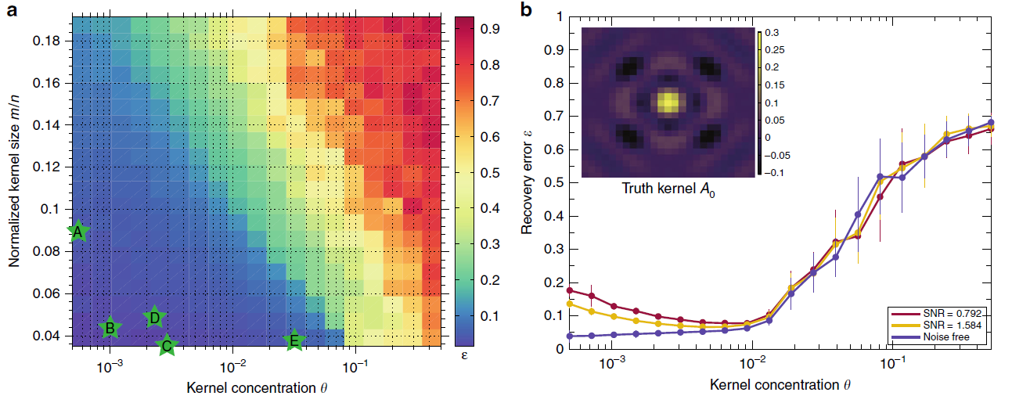
Effectiveness of the algorithm in the parameter space
Concentration of the scatters: theta θ (density of 1’s in the activation map)
Size of kernel: n= N*N
Size of observations: m = M*M
Area ratio: n/m
Sky C. Cheung etal (2020)

Slide 3
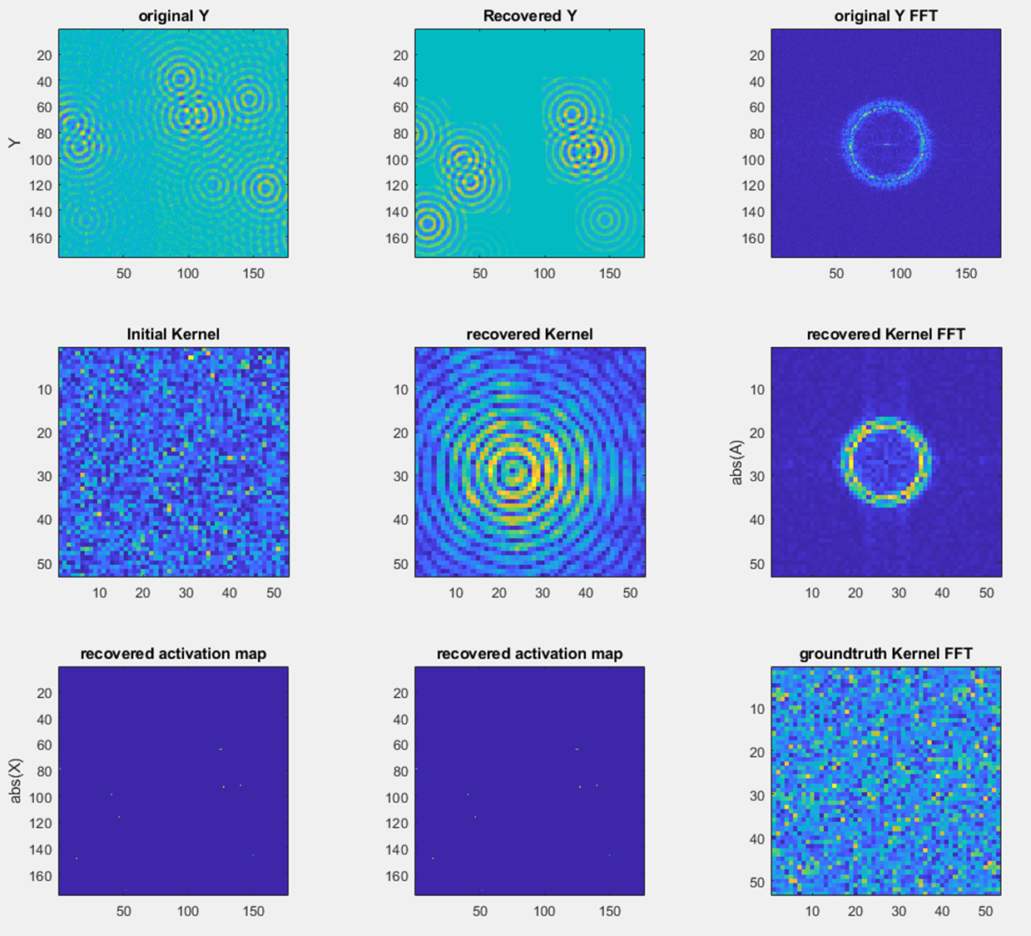
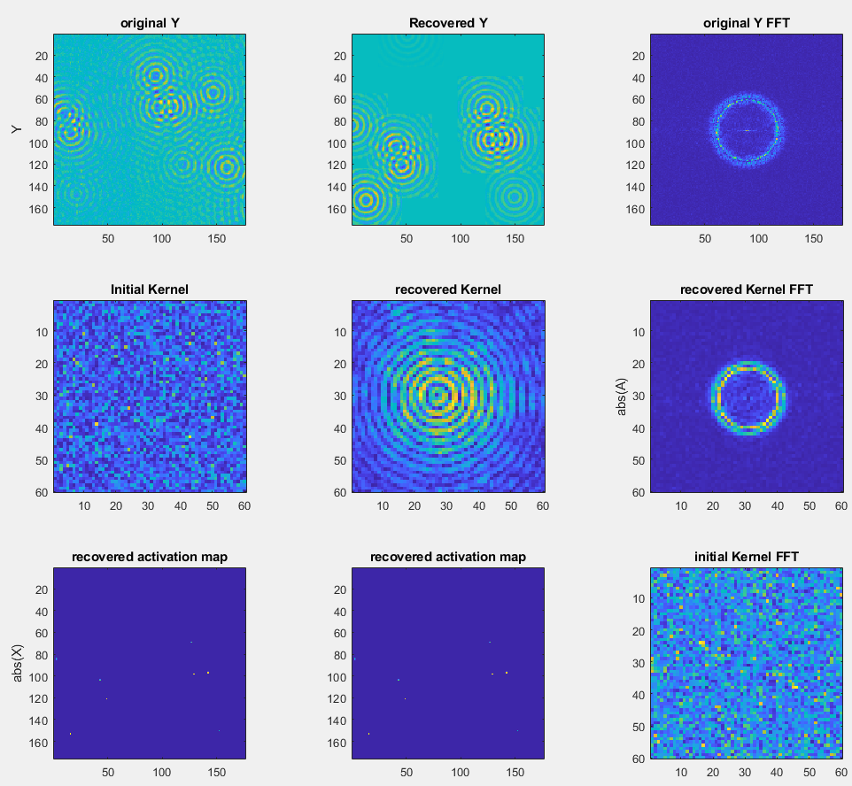
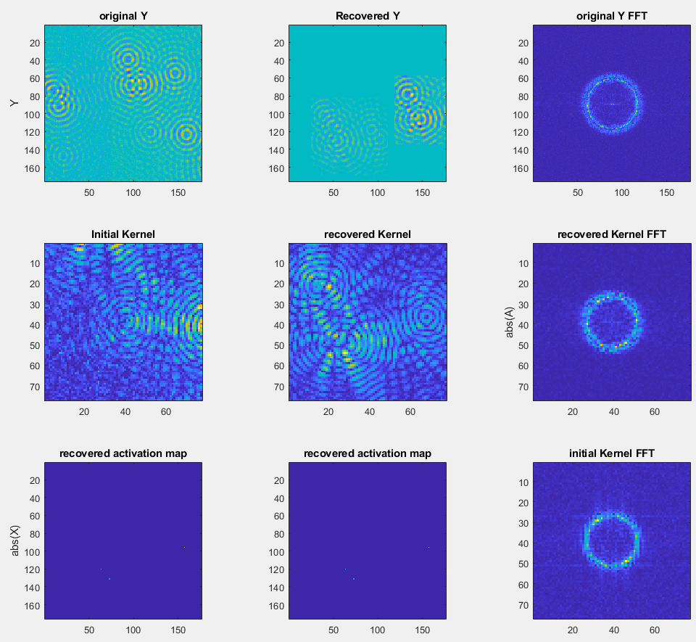
Test on the area ratio vs effectiveness
Observation size = [176 176]
Observation size = [176 176]
Observation size = [176 176]
Kernel size = [53 53]
Kernel size = [60 60]
Kernel size = [77 77]

Slide 4
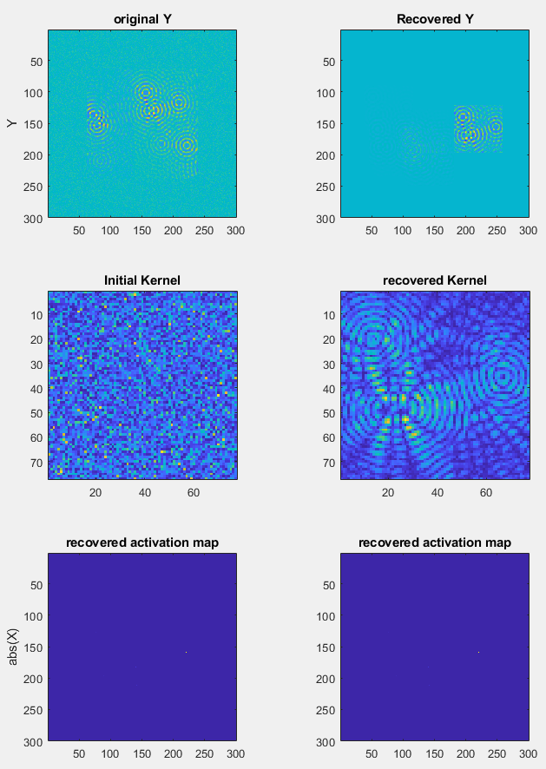
Test on the area ratio vs effectiveness
Padding with background mean and variance
Observation size = [176 176]
Observation size = [176 176]
Observation size = [300 300]
Kernel size = [60 60]
Kernel size = [77 77]
Kernel size = [77 77]

Slide 5
Test unpadded data with bigger lambda
Observation size = [176 176]
Observation size = [176 176]
Observation size = [300 300]
Kernel size = [60 60]
Kernel size = [77 77]
Kernel size = [77 77]

Slide 6
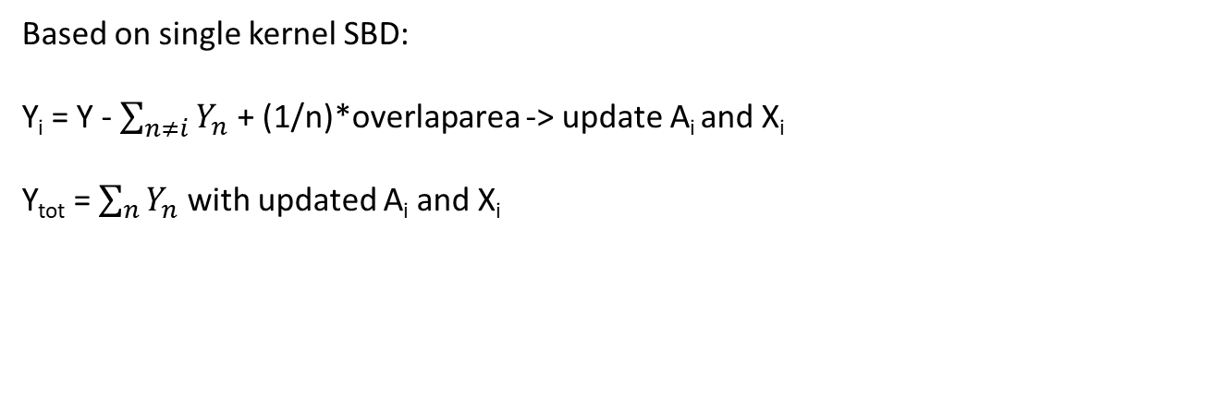
Multi-kernel development
Based on single kernel SBD:
Y_{i} = Y - $\sum_{n≠i}{Y_{n}}$ + (1/n)*overlaparea -> update A_{i} and X_{i}
Y_{tot} = $\sum_{n}{Y_{n}}$ with updated A_{i} and X_{i}

Slide 7
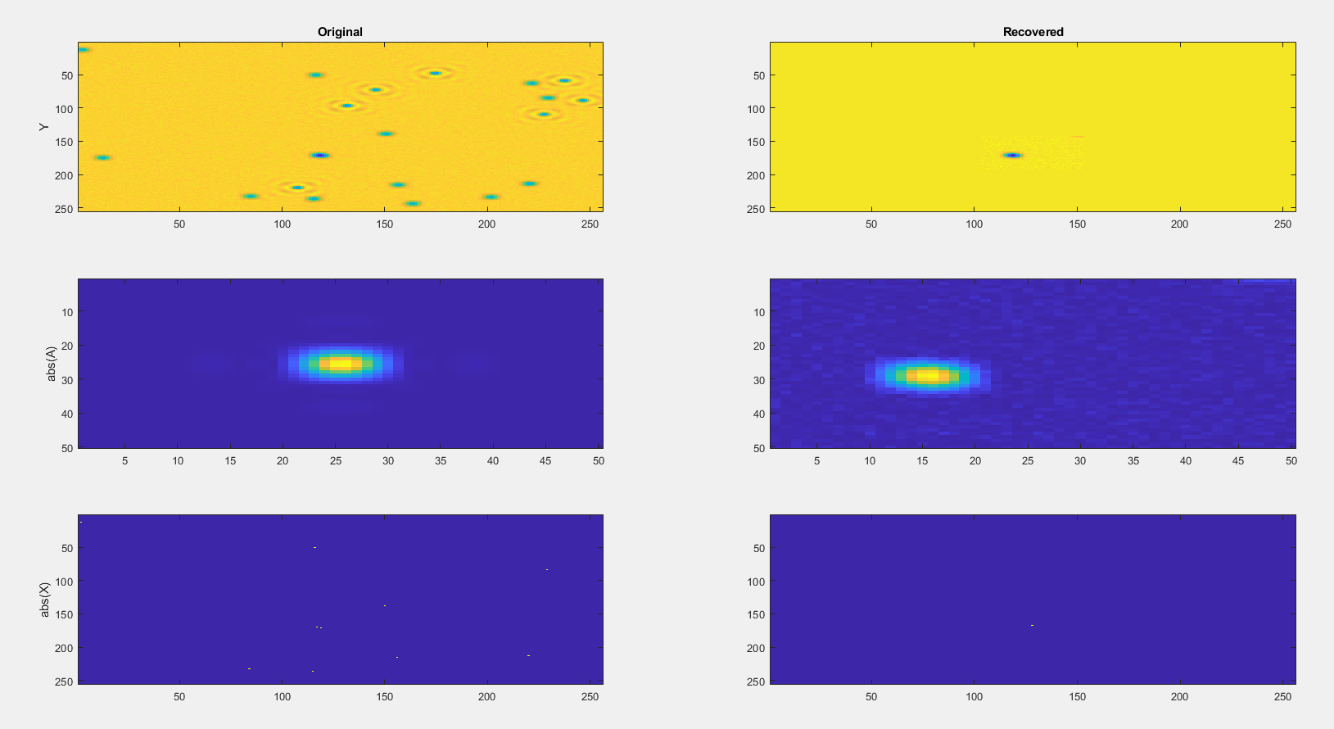
Edge case collections

Slide 8
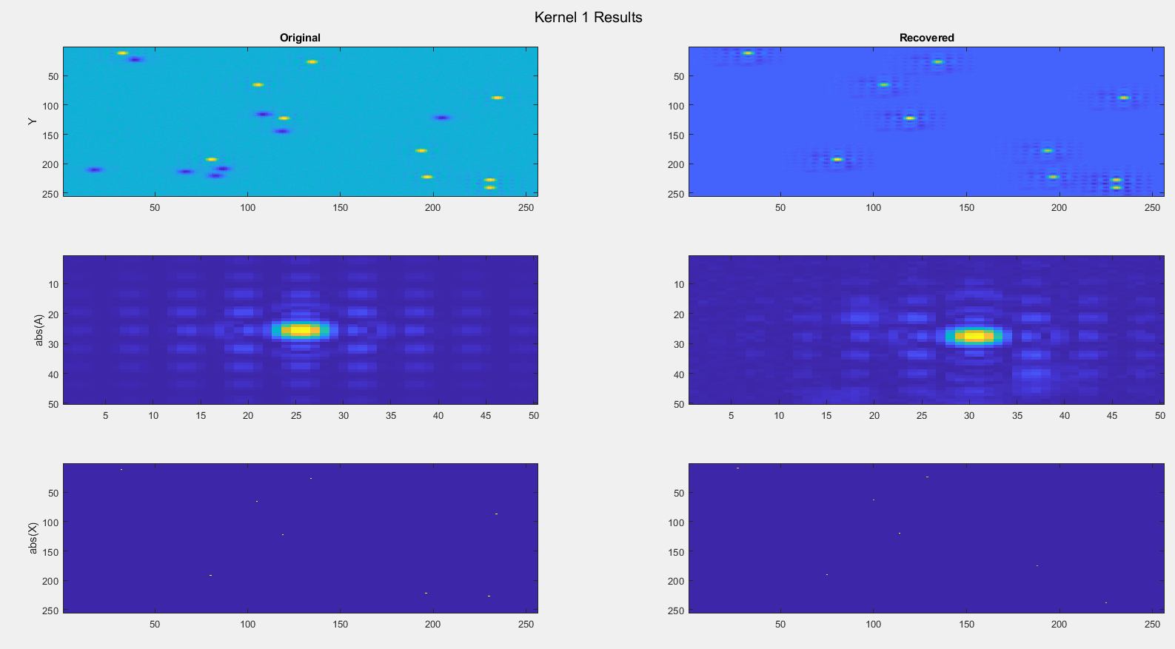
Result_1st working run

Slide 9
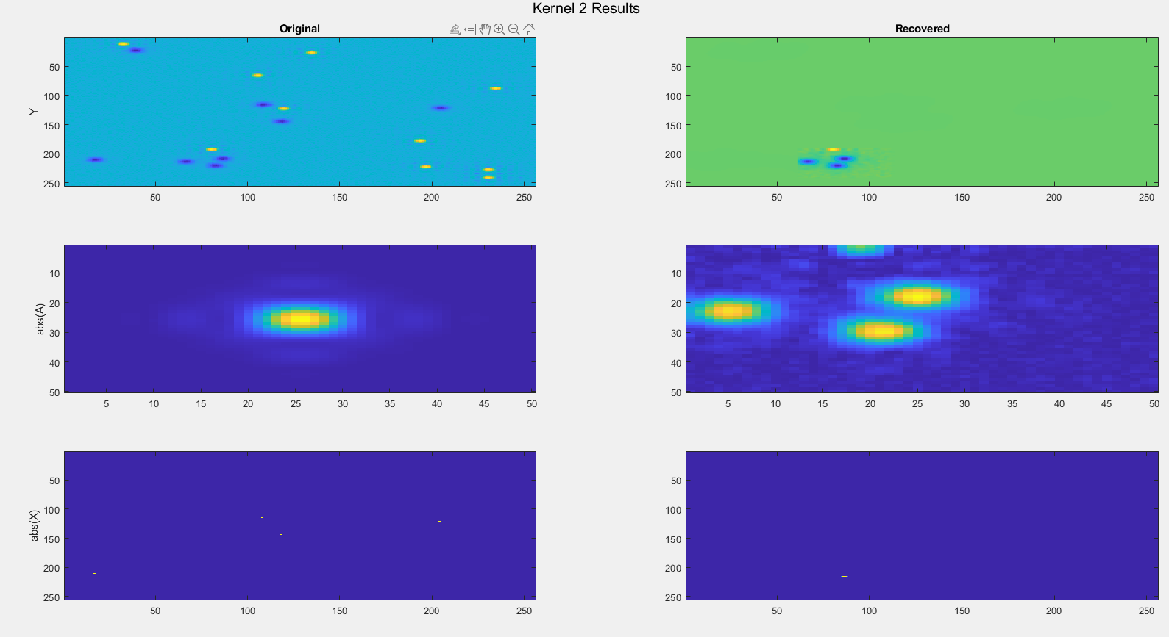
Result_1st working run

Slide 10
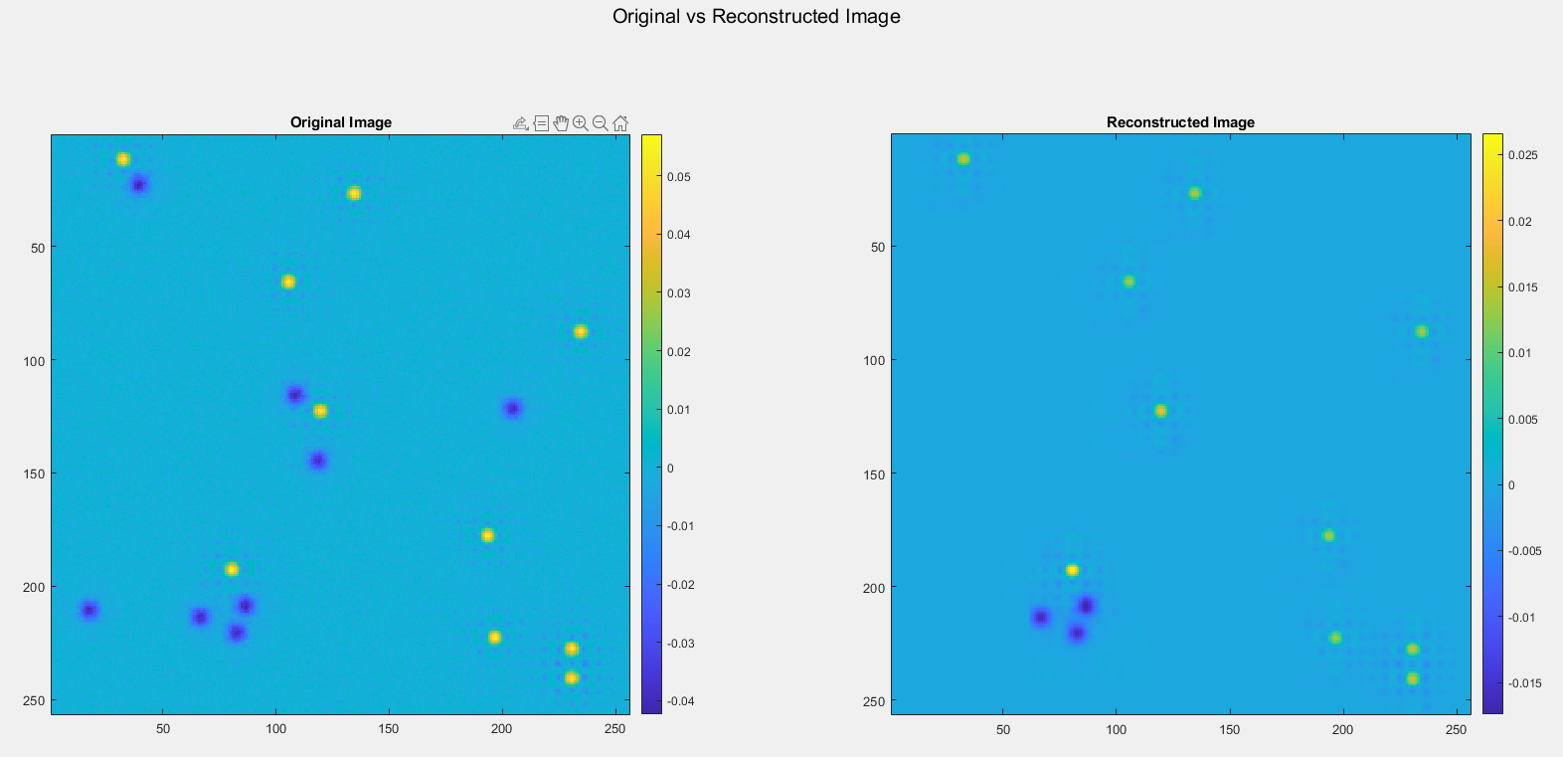
Result_1st working run

Slide 11
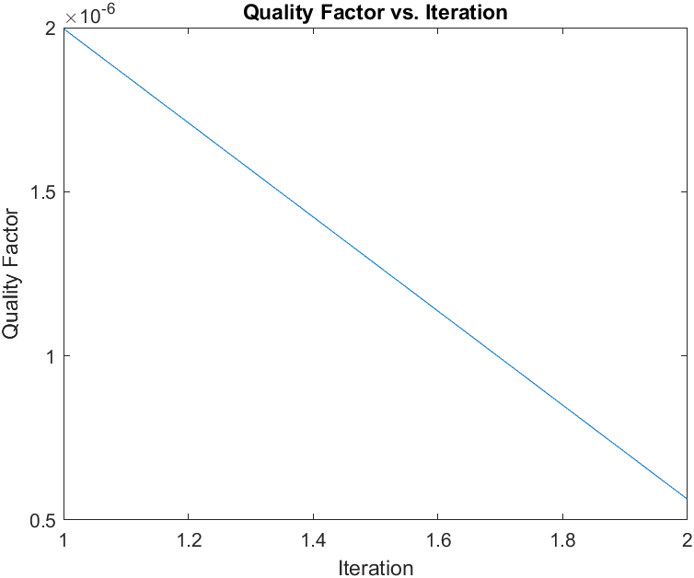
Result_1st working run

Slide 12
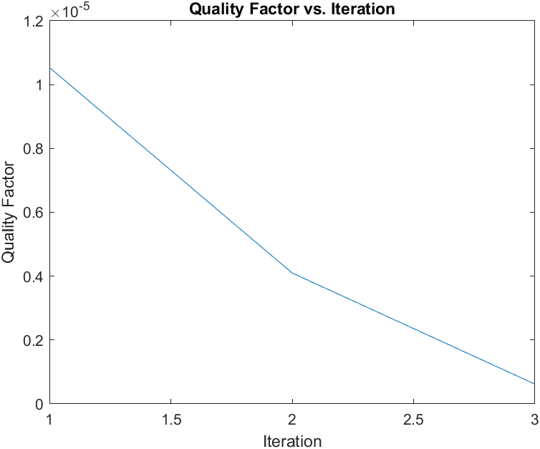
Result_2nd working run

Slide 13
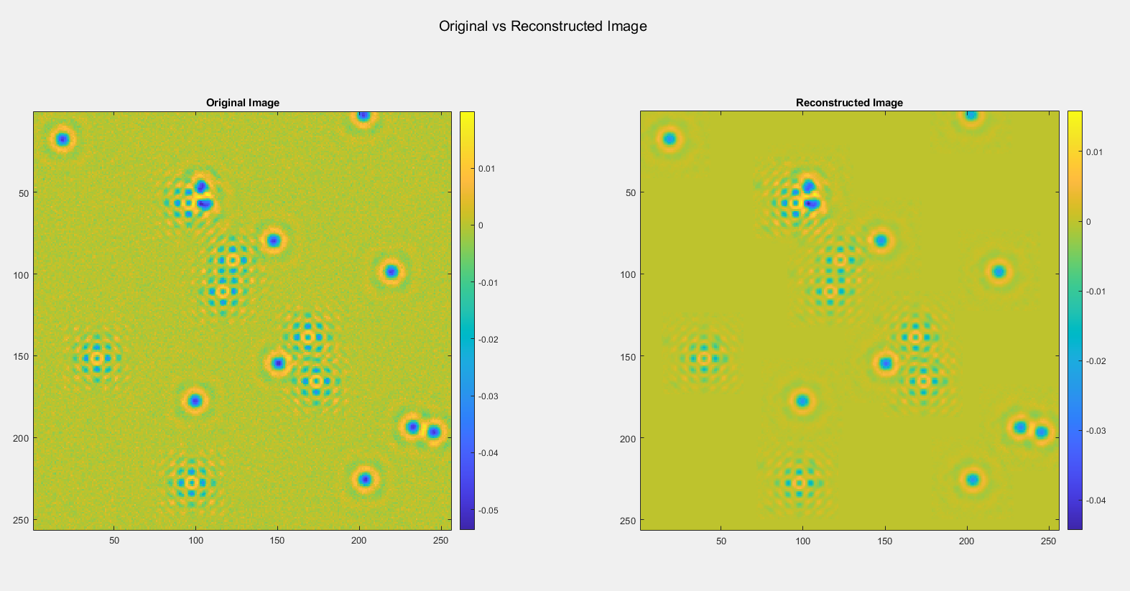
Result_2nd working run

Slide 14
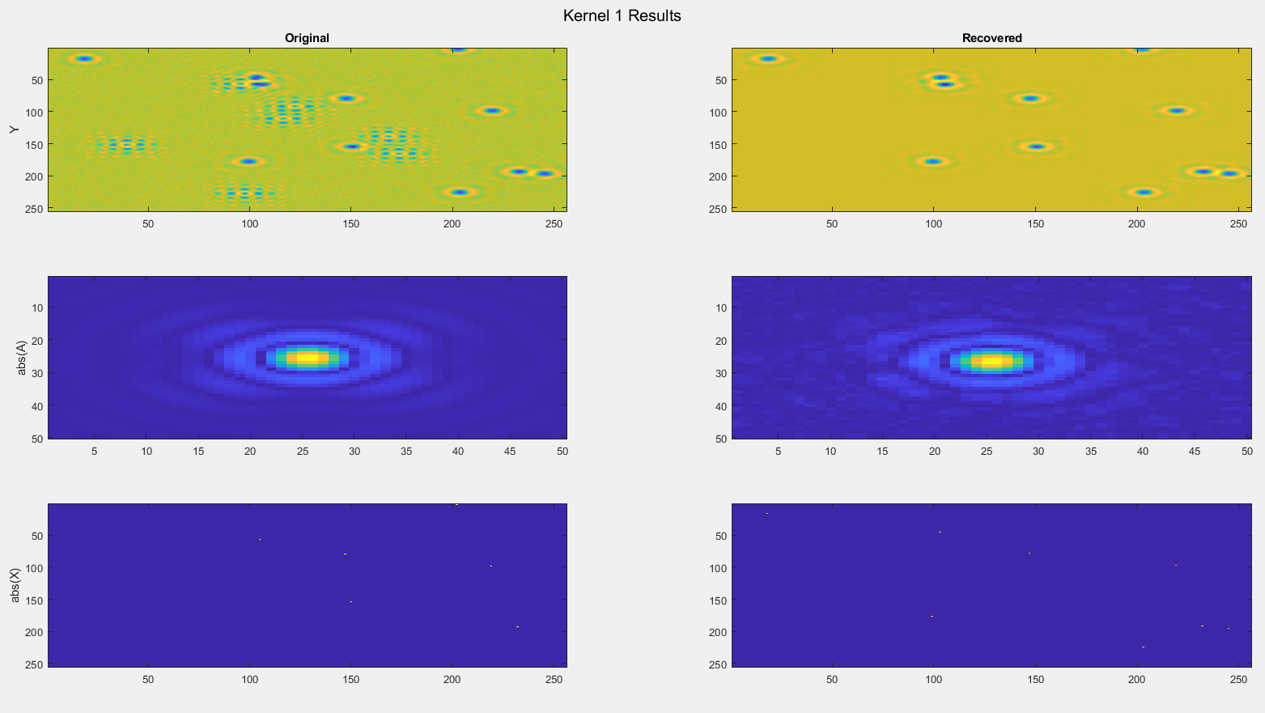
Result_2nd working run

Slide 15
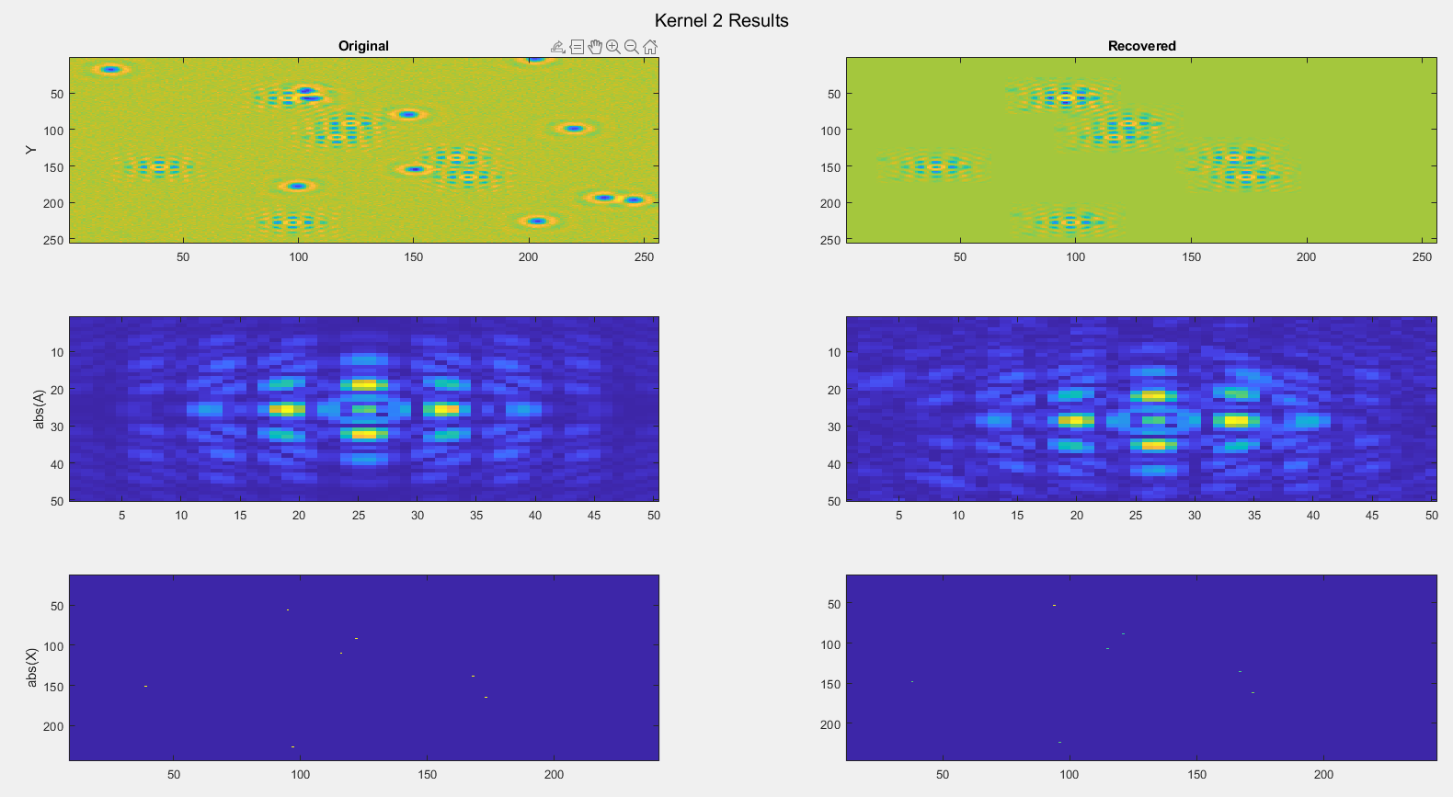
Result_2nd working run

Slide 16
Result_2nd working run

Slide 17
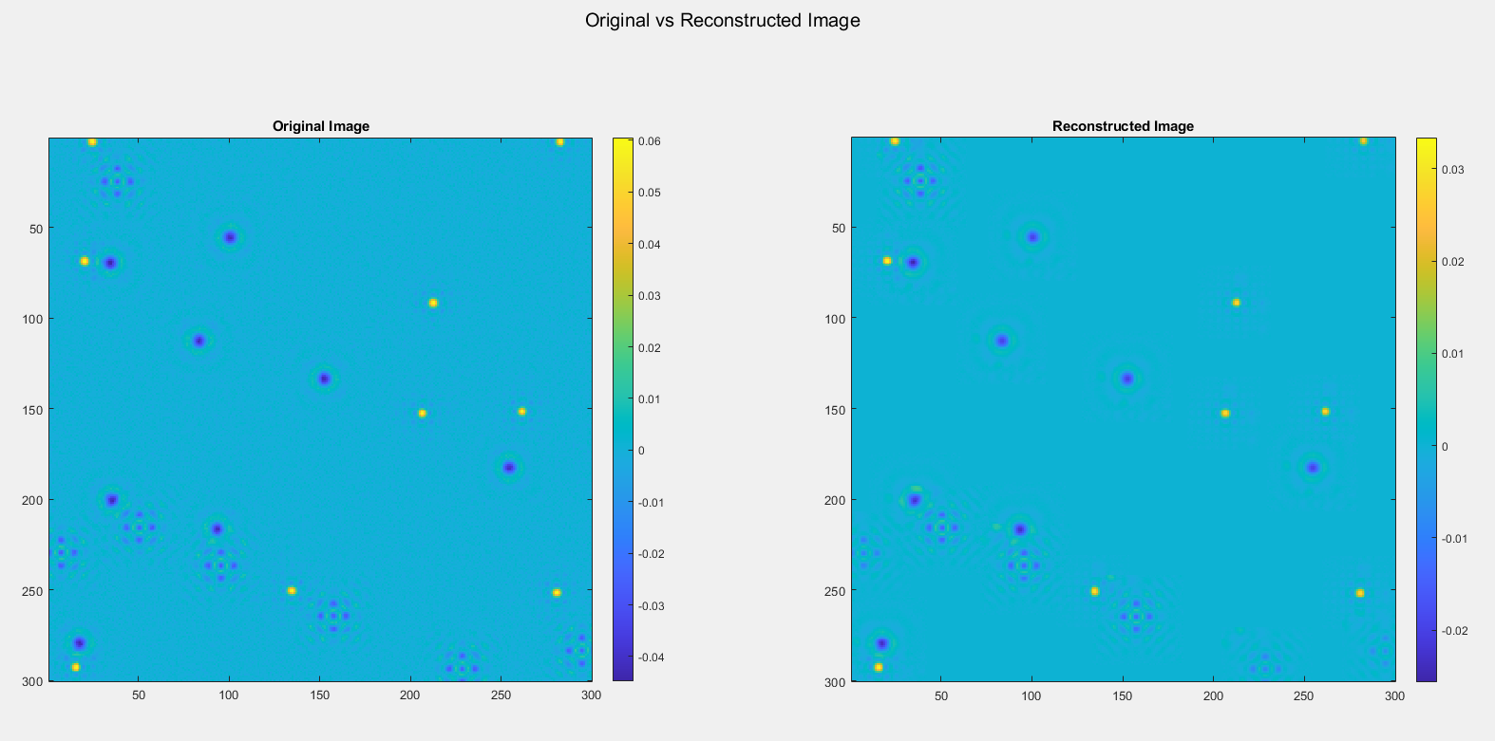
Scaling test:
MAXit = 3

Slide 18
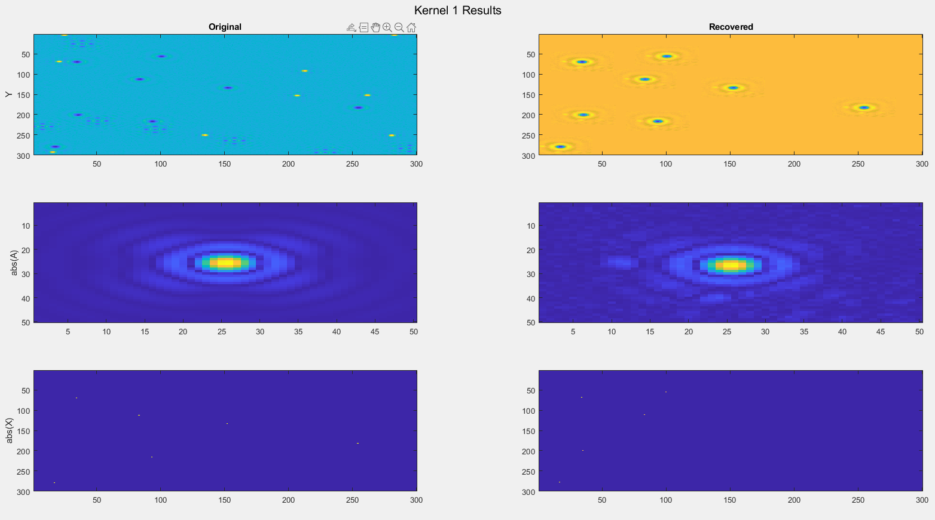
Scaling test:
MAXit = 3

Slide 19
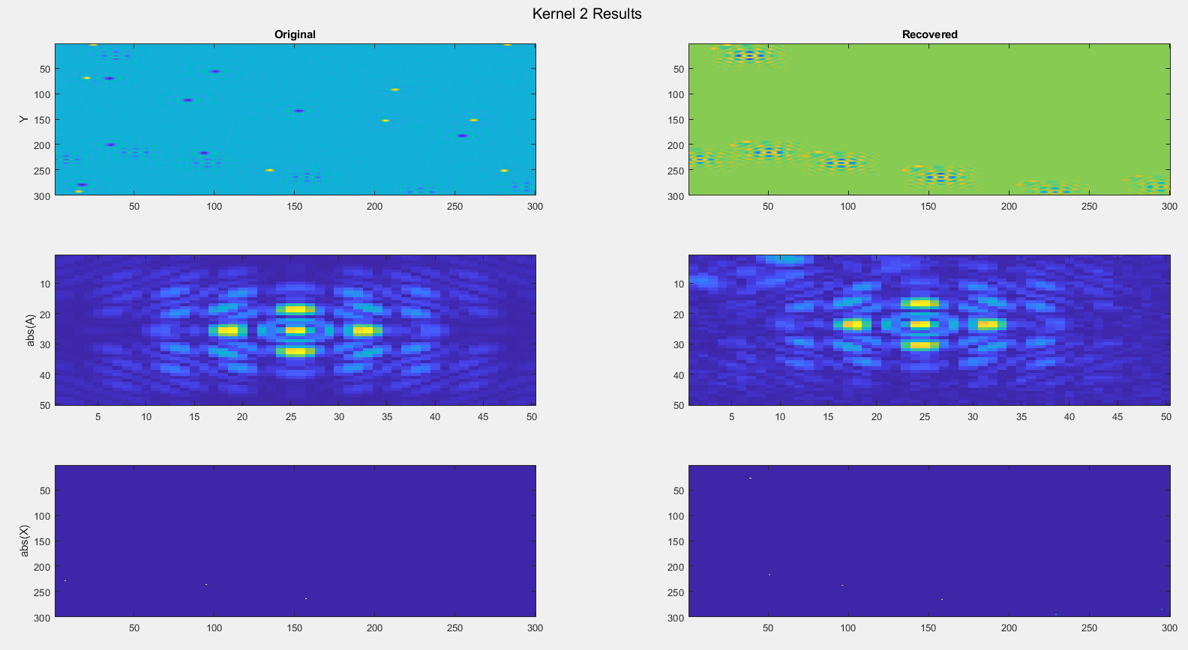
Scaling test:
MAXit = 3

Slide 20
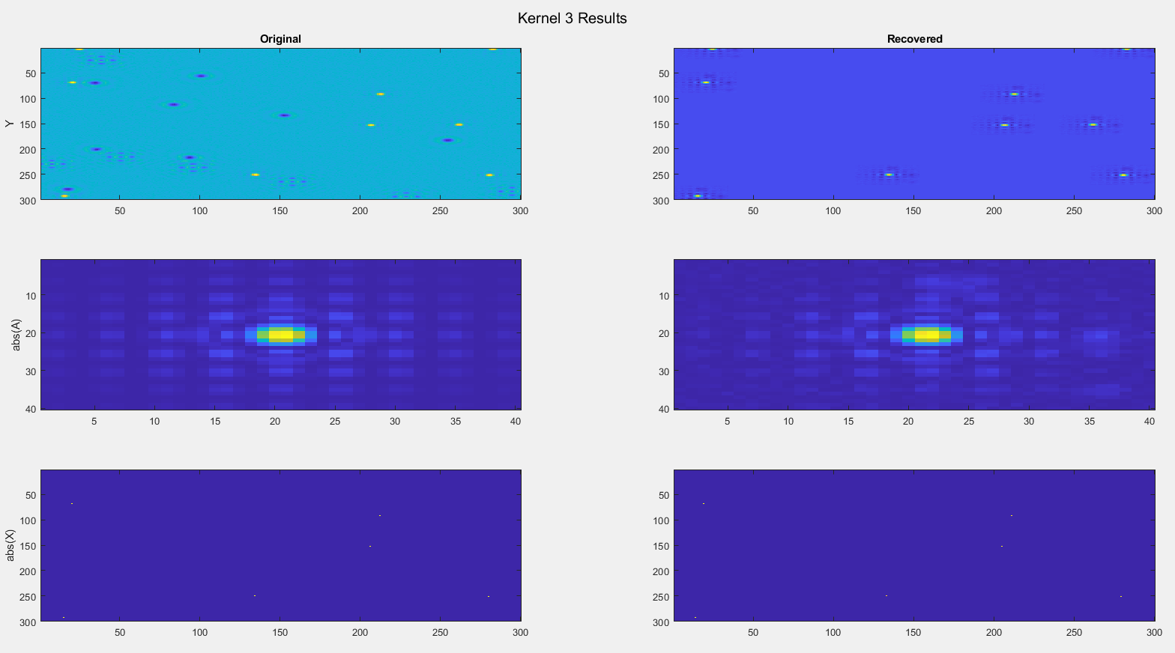
Scaling test:
MAXit = 3

Slide 21
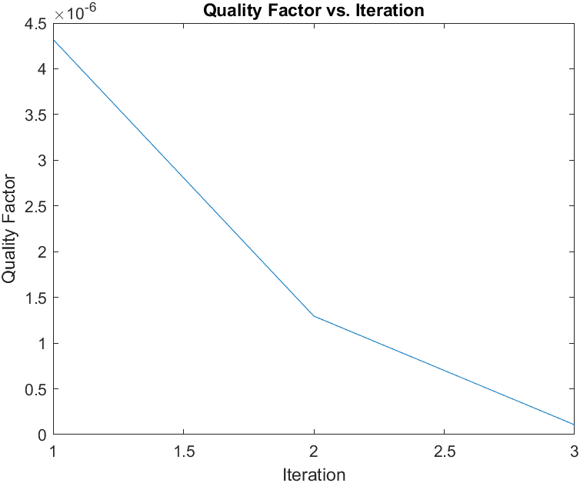
Scaling test:
MAXit = 3

Slide 22
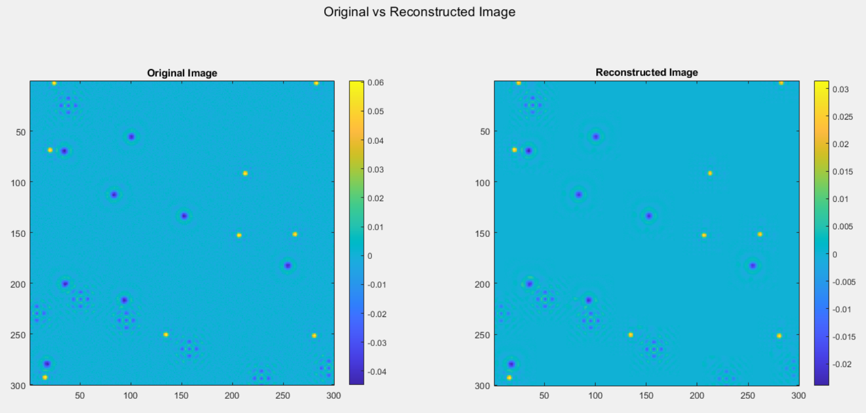
Scaling test:
MAXit = 100

Slide 23
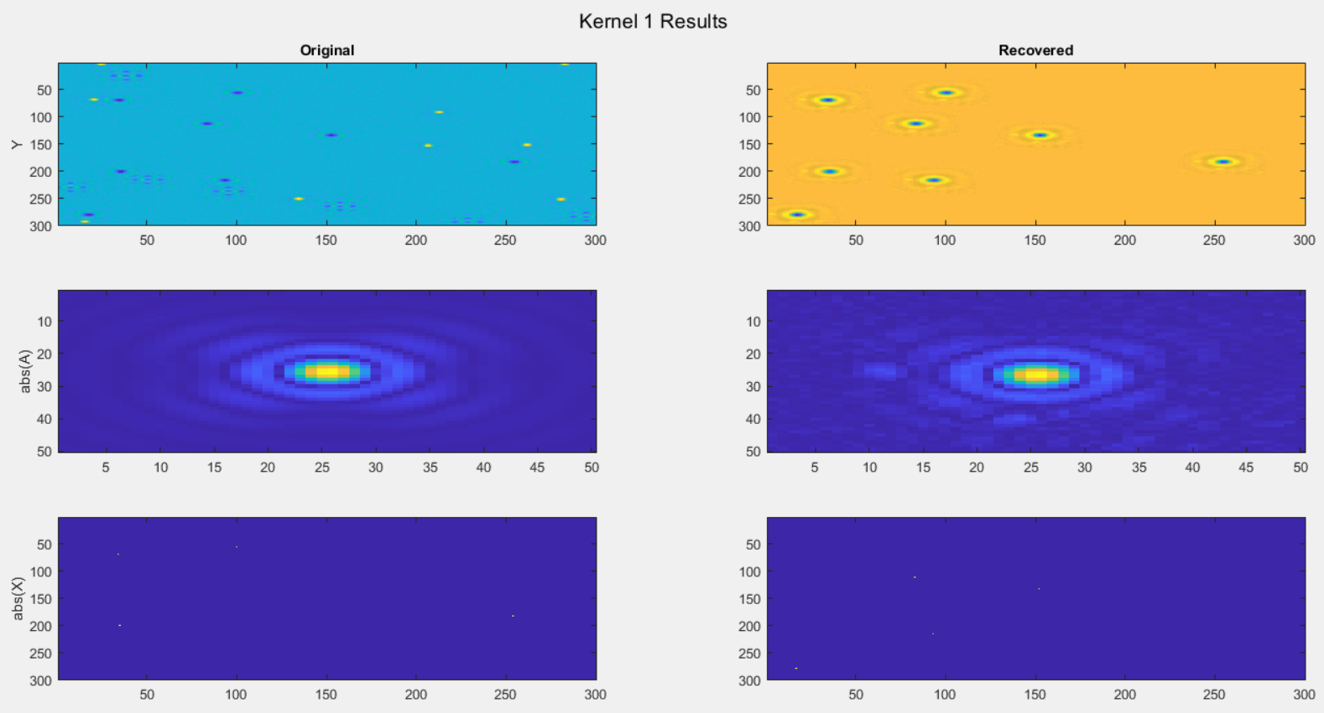
Scaling test:
MAXit = 100

Slide 24
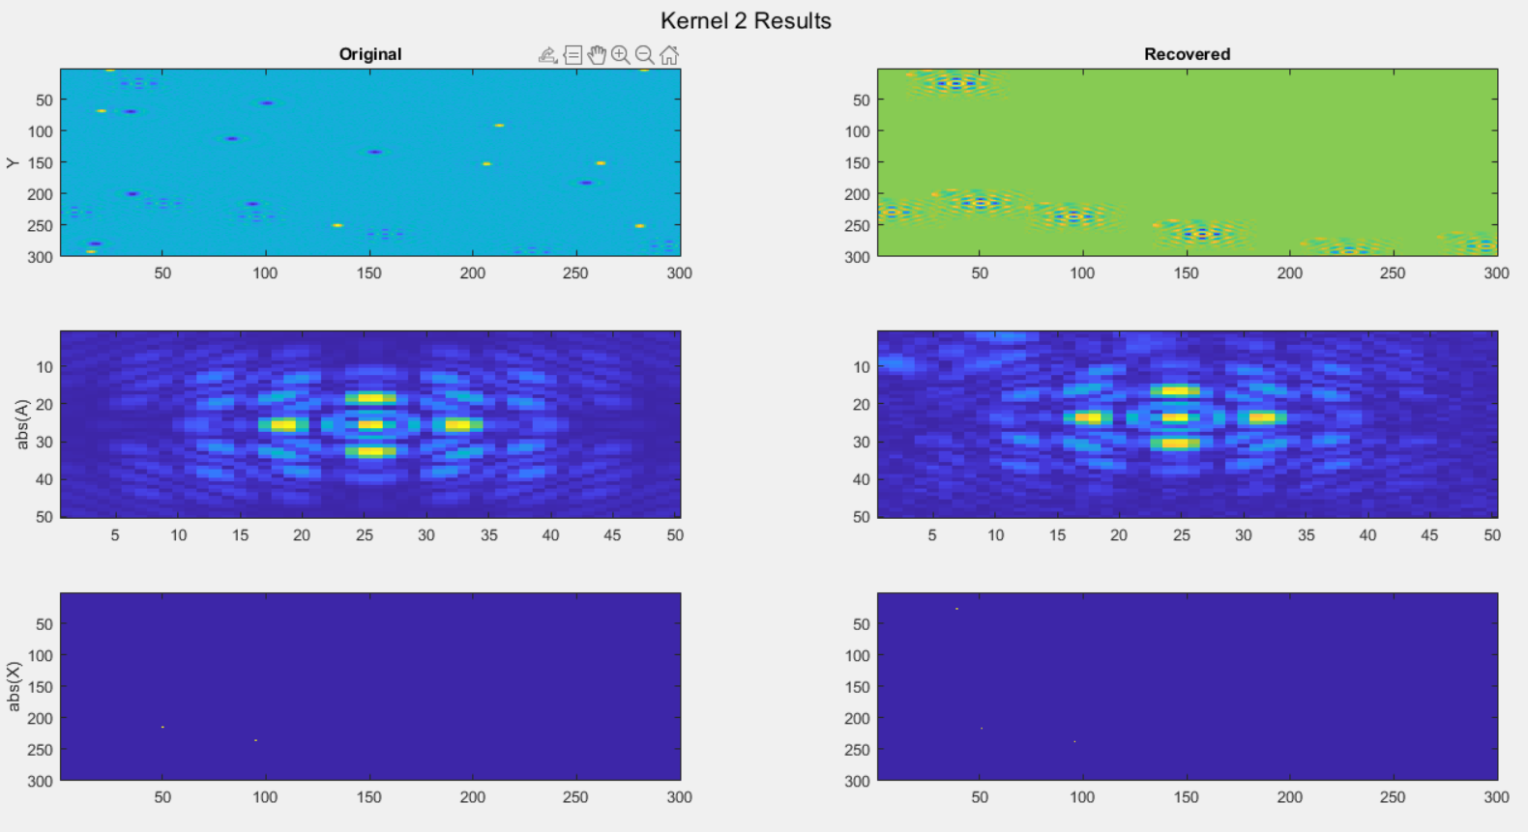
Scaling test:
MAXit = 100

Slide 25

Scaling test:
MAXit = 100

Slide 26
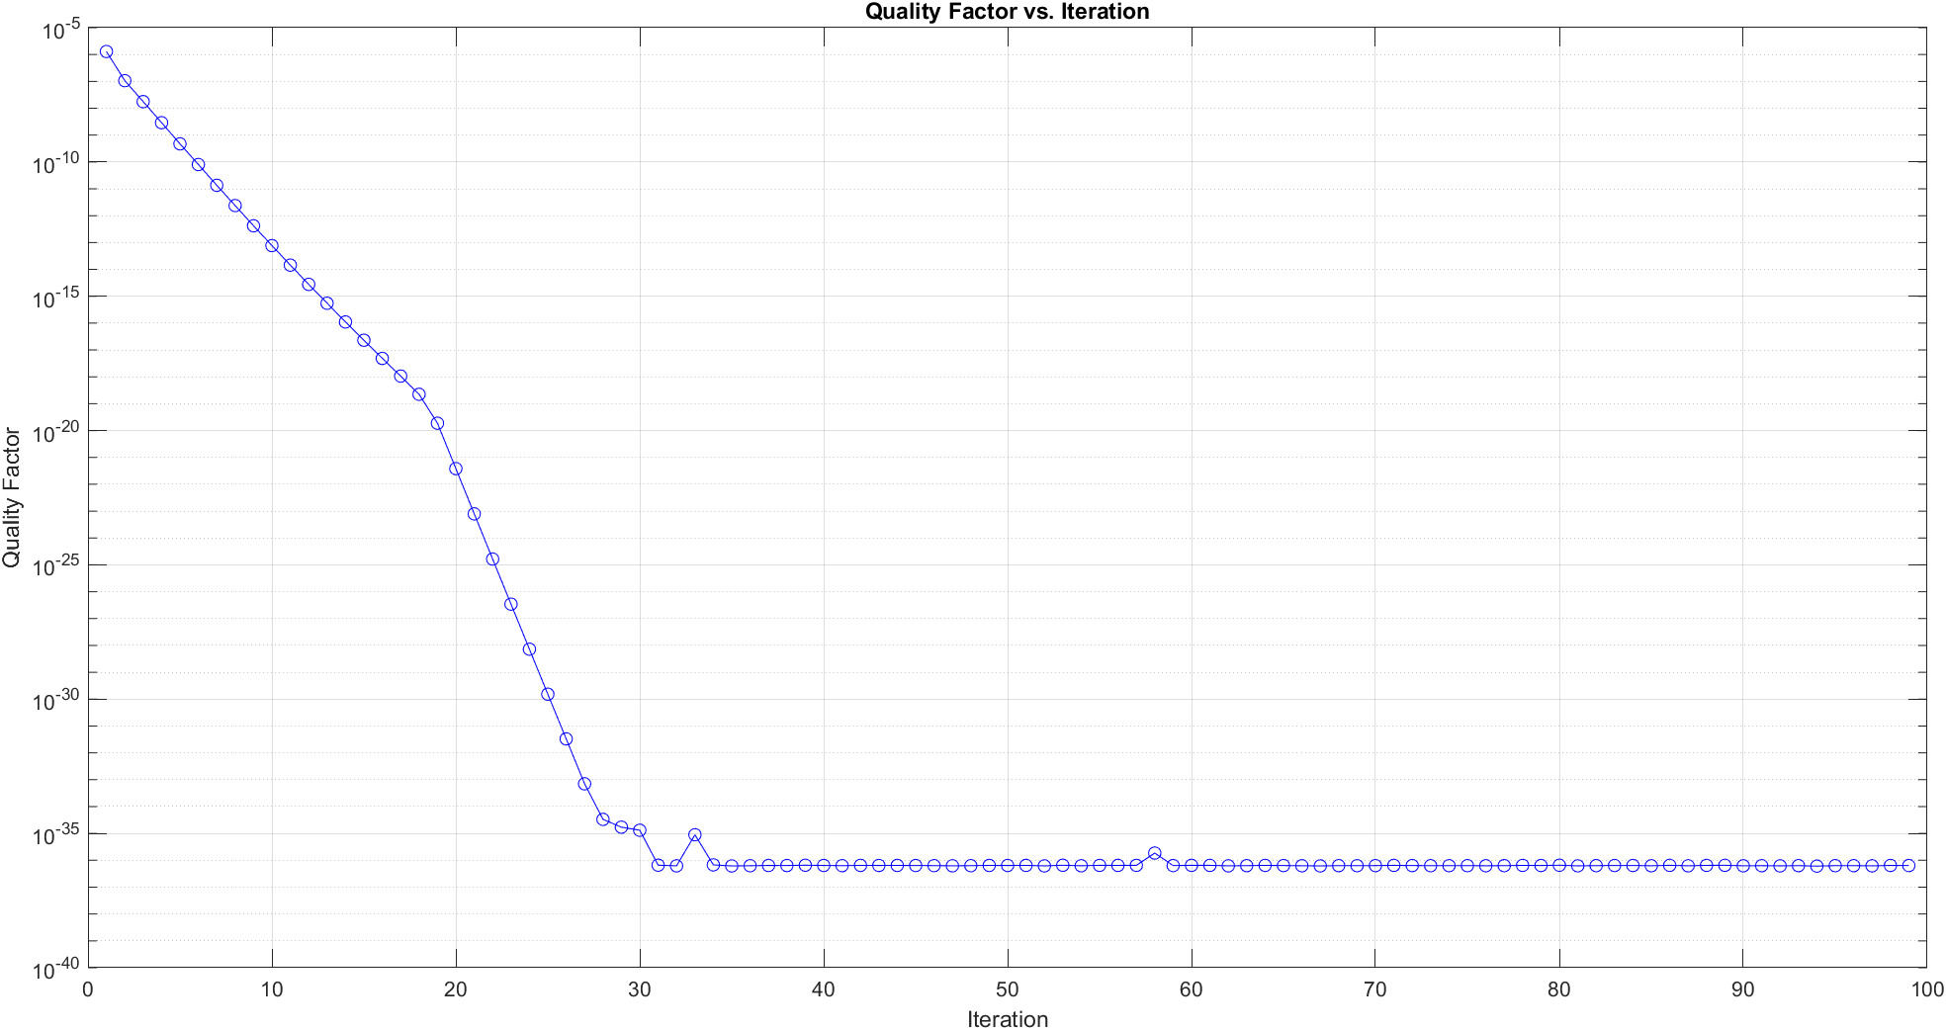
Scaling test:
MAXit = 100

Slide 28
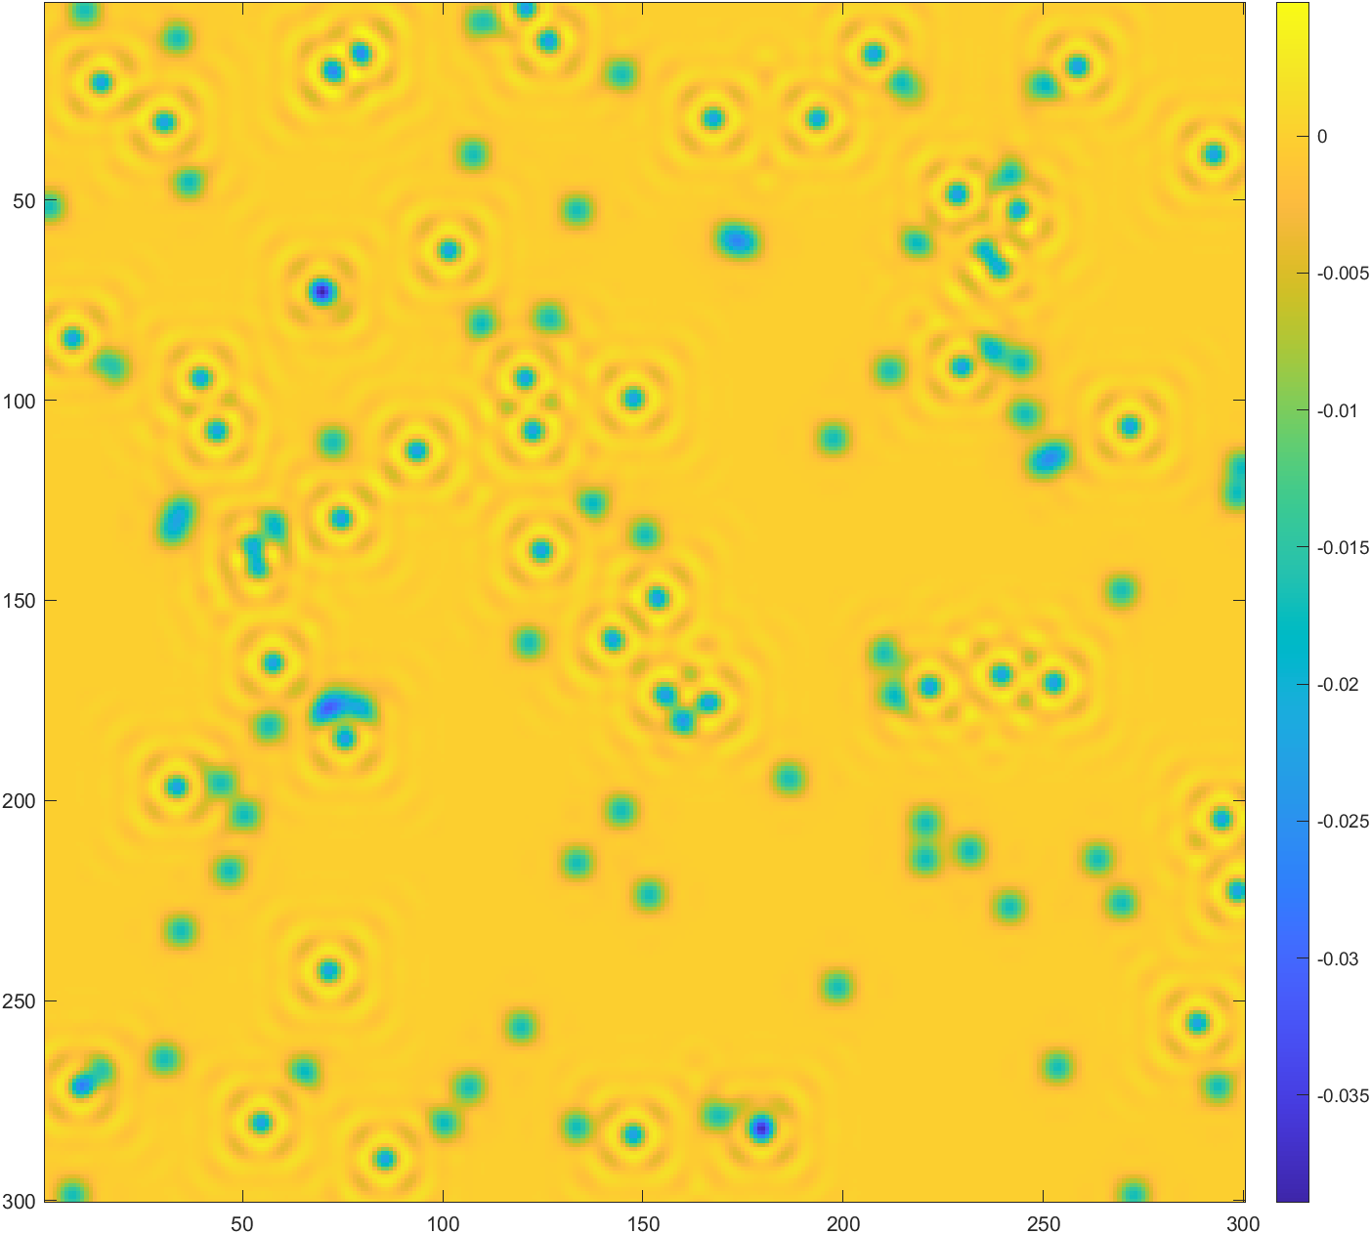
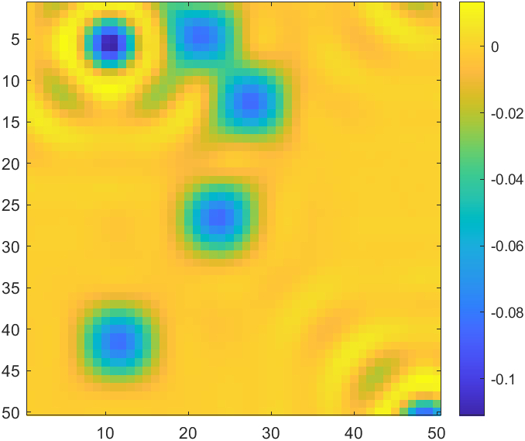
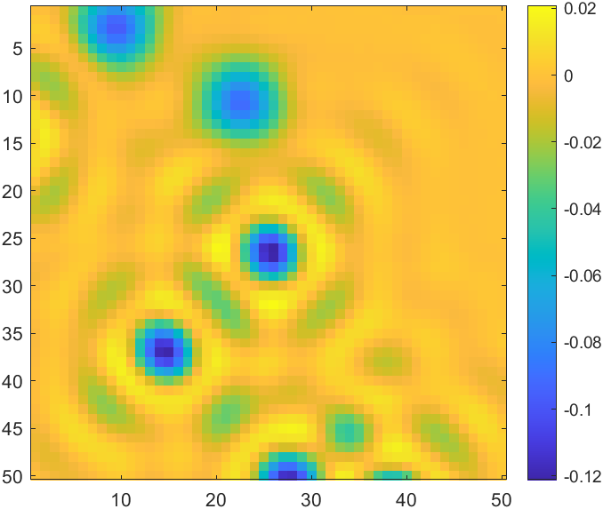
Noise_free
SNR=10000, dense, test
Initial guesses

Slide 29
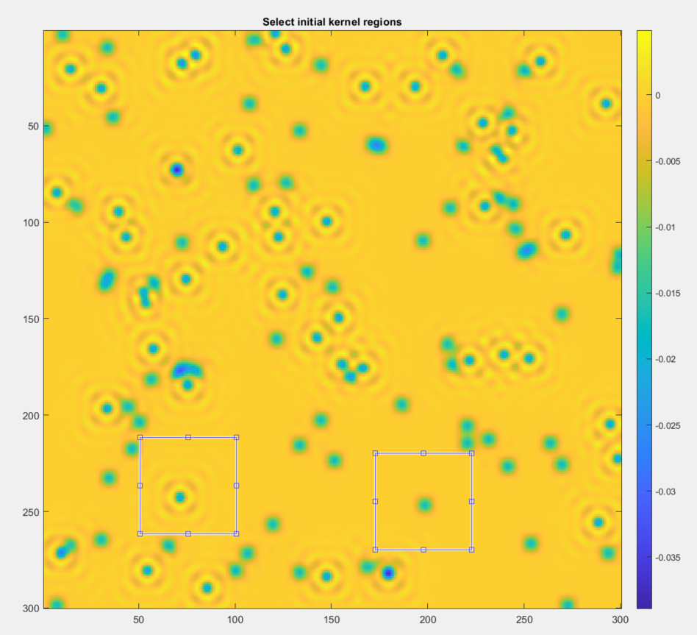
Noise_free
SNR=10000, dense, test
Initial guesses
Kernel 2
Kernel 1

Slide 30
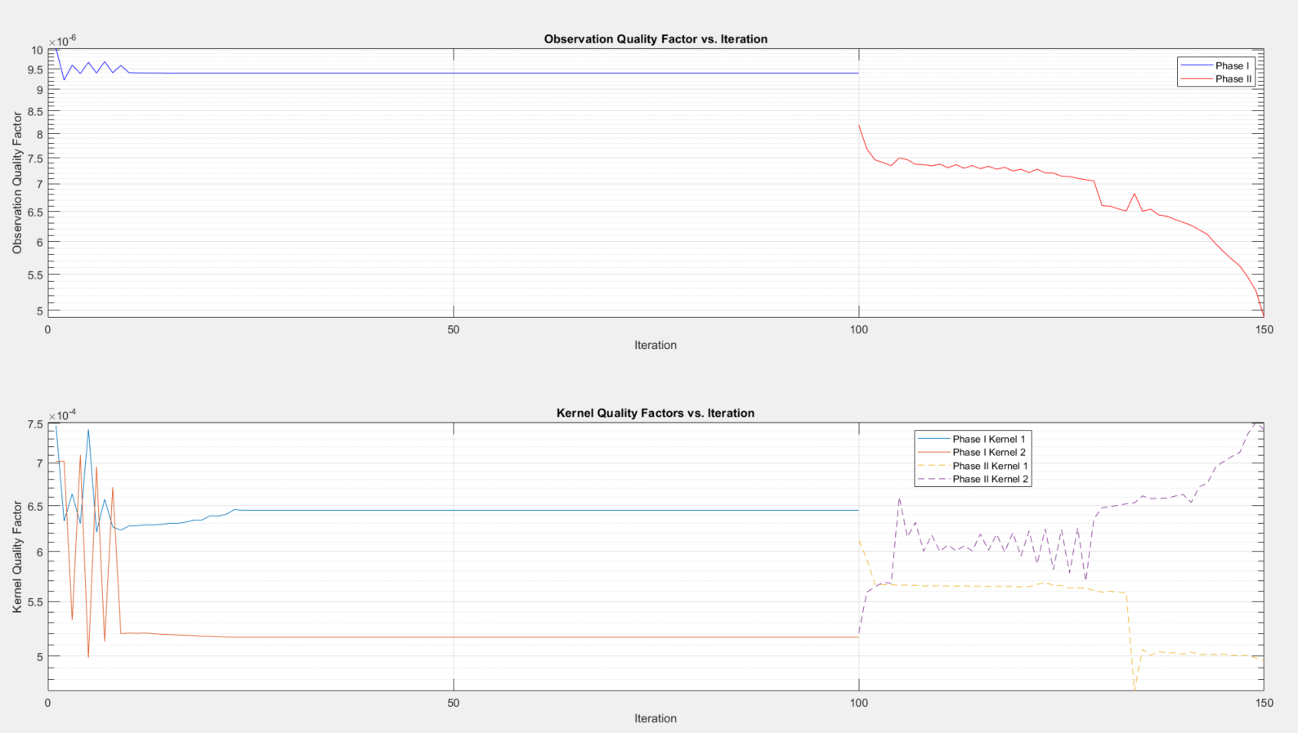
Noise_free SNR=10000, dense, test

Slide 31
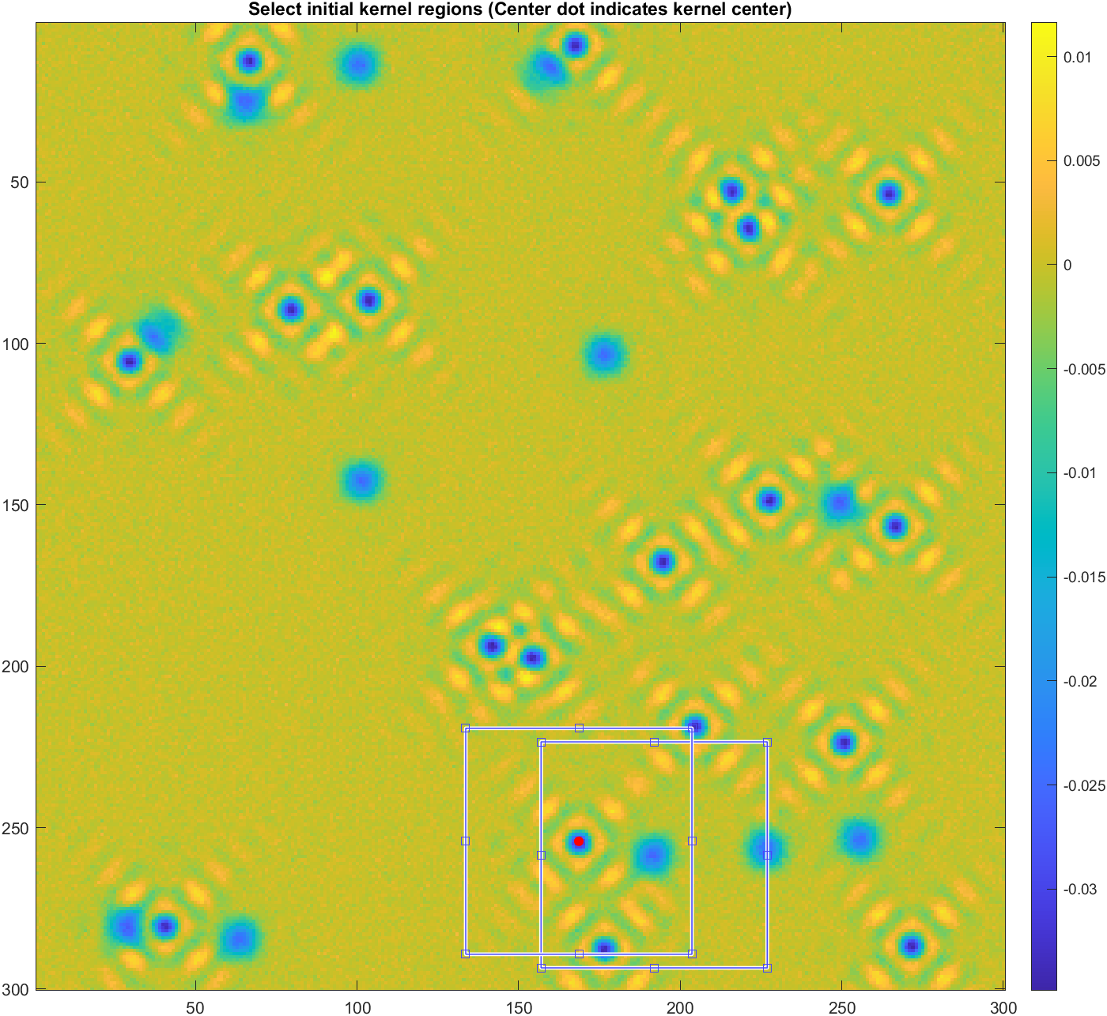
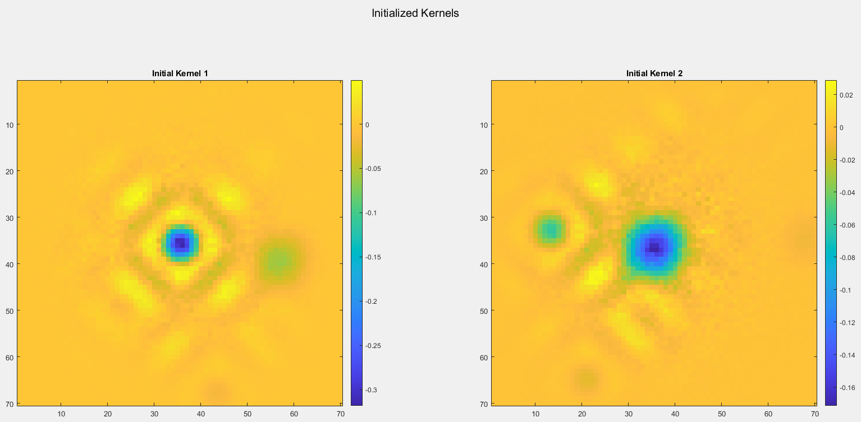
Algorithm design – gaussian window on initial kernel
SNR = 10;
theta_cap = 2*1e-4;
theta = theta_cap/2 + theta_cap/2 * rand(1, num_kernels); % Generate num_kernels thetas capped by theta_cap
num_kernels = 2;
n = 1; % number of energy layers per kernel, default 1
image_size = [300, 300];
kernel_size = zeros(num_kernels,2);
kernel_size(1,:) = [70, 70];
kernel_size(2,:) = [70, 70];
Gaussian_alpha=2.5;

Slide 32
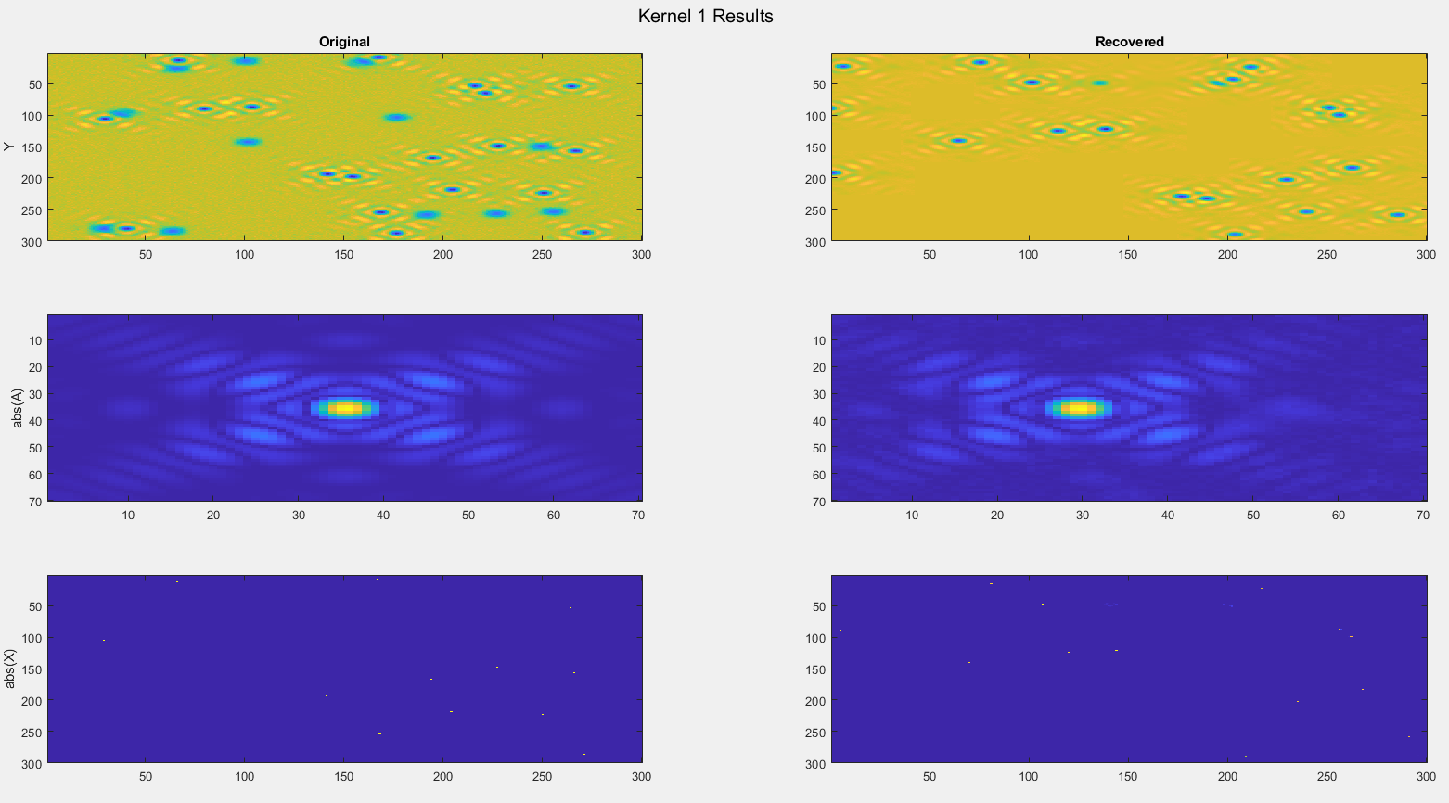
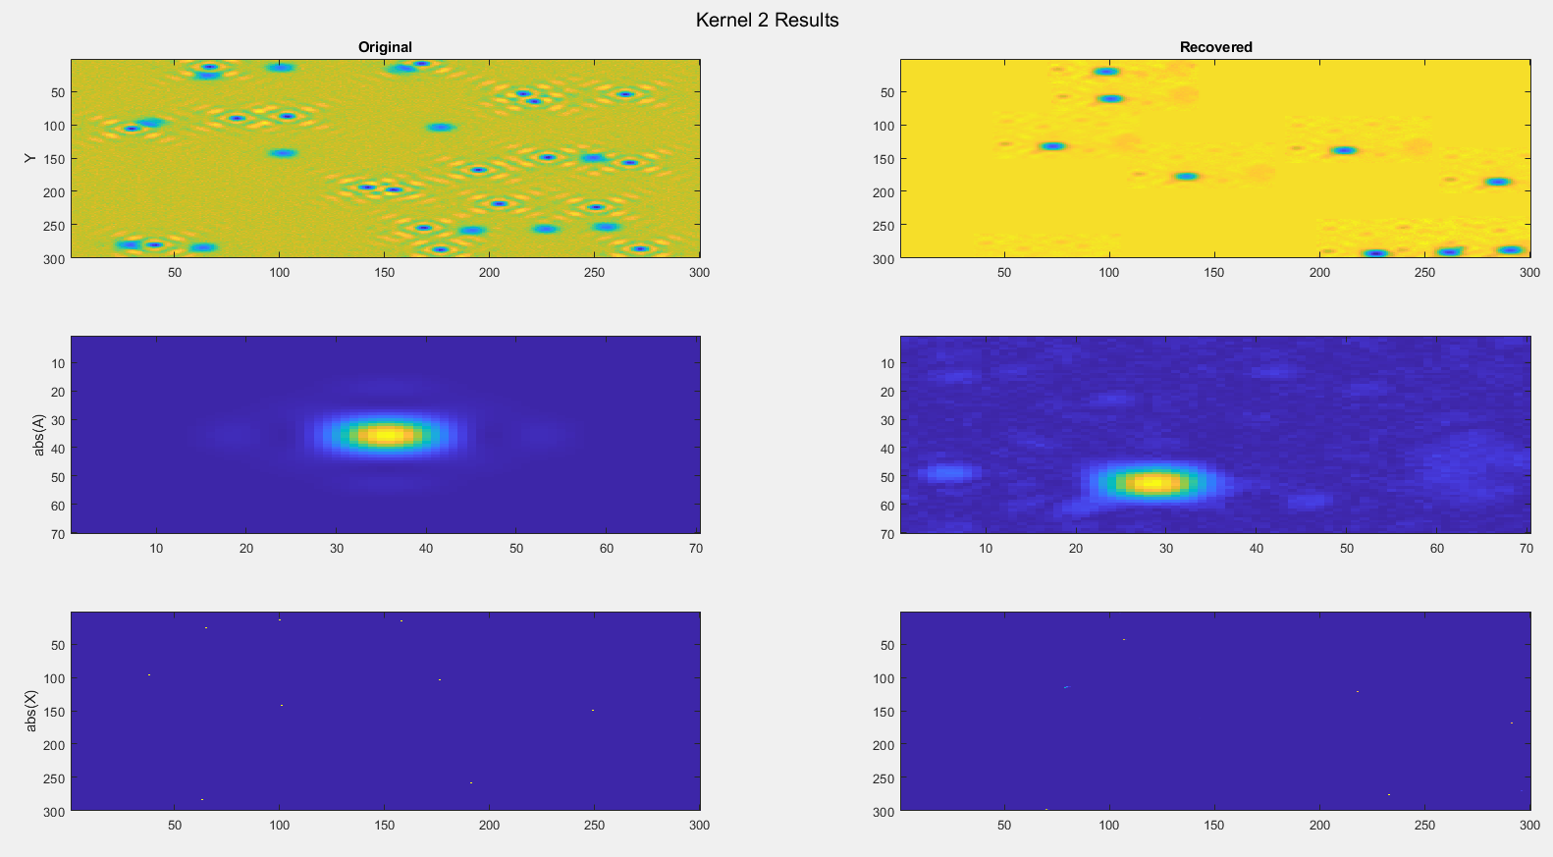

Slide 33
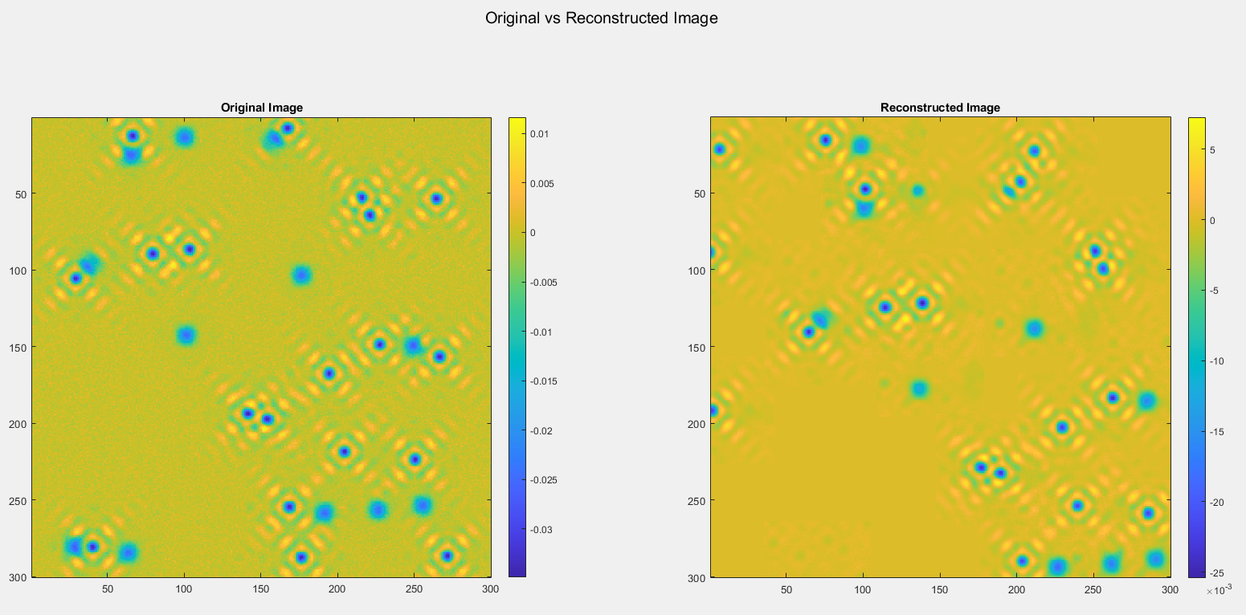

Slide 34
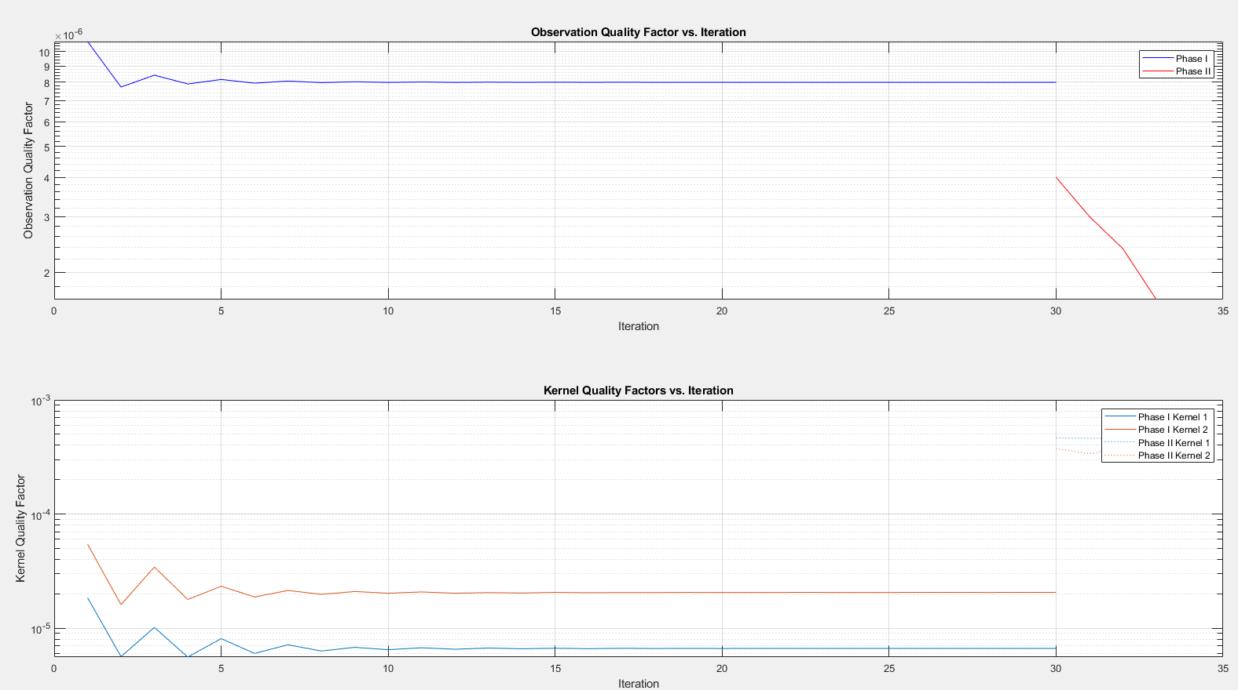

Slide 35
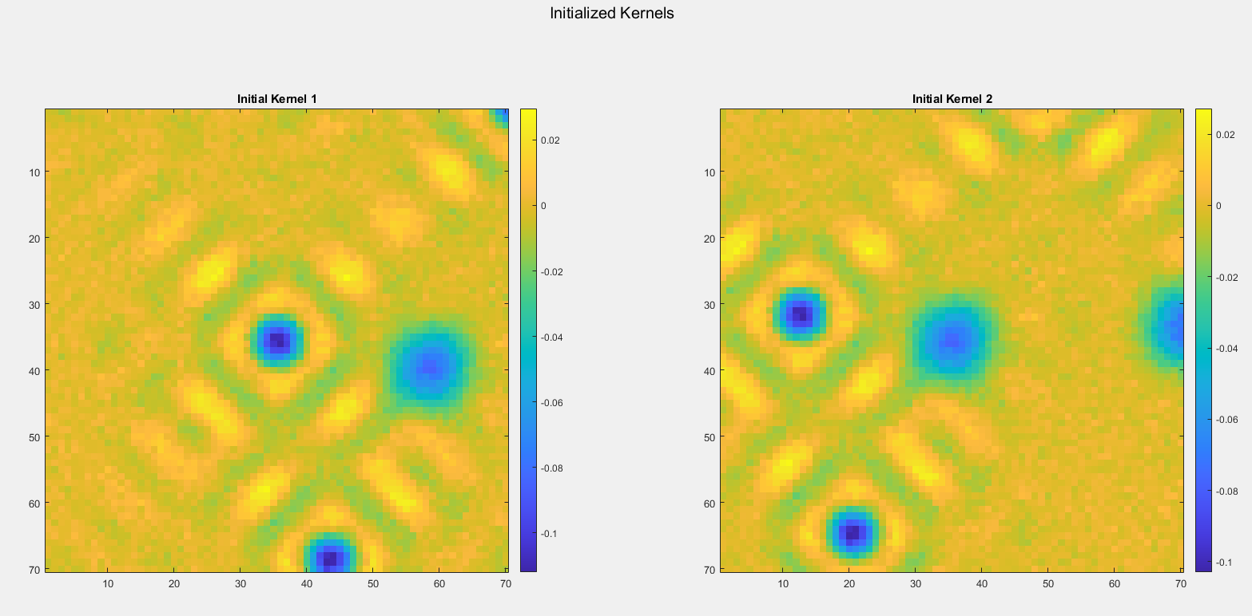
Everything the same,
Except NO gaussian filter on initial guess

Slide 36
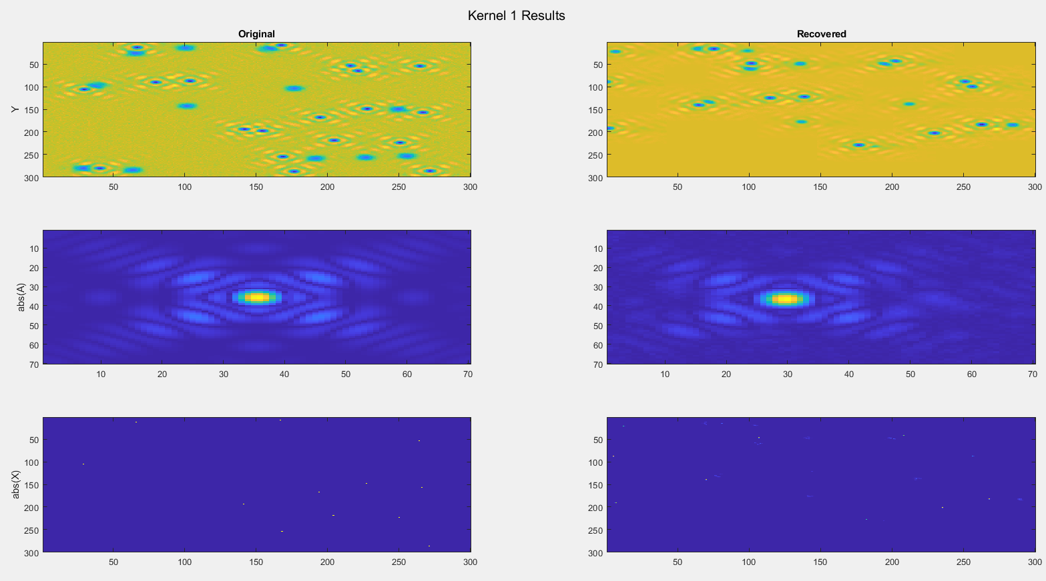
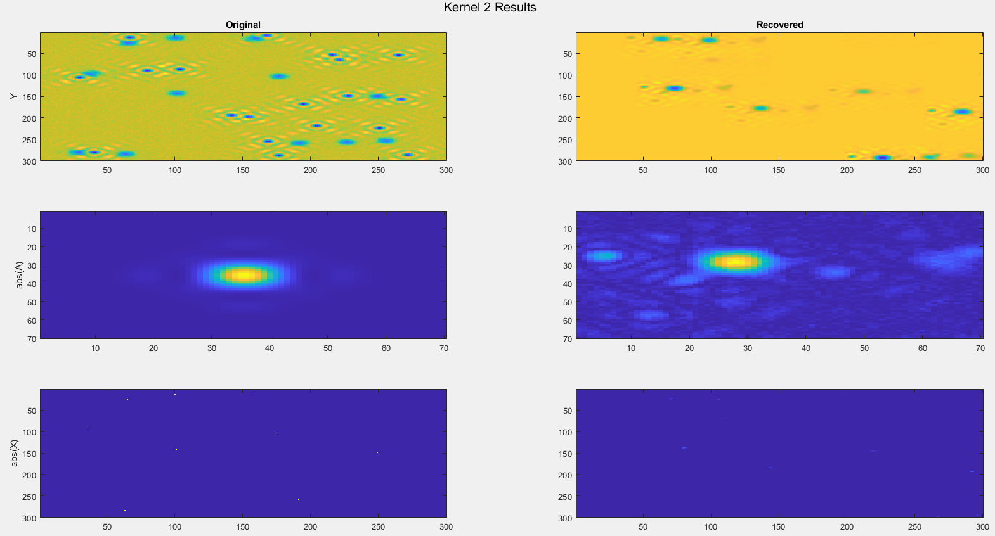

Slide 37
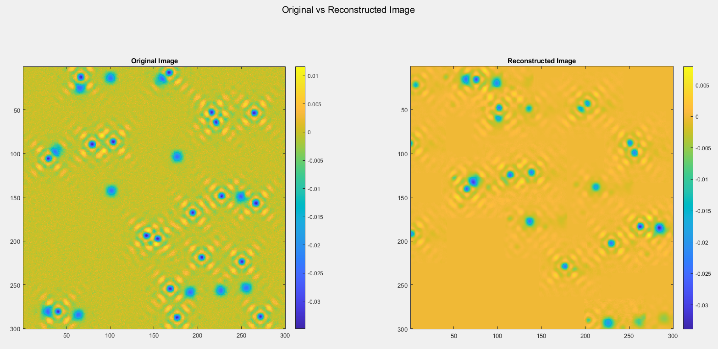

Slide 38
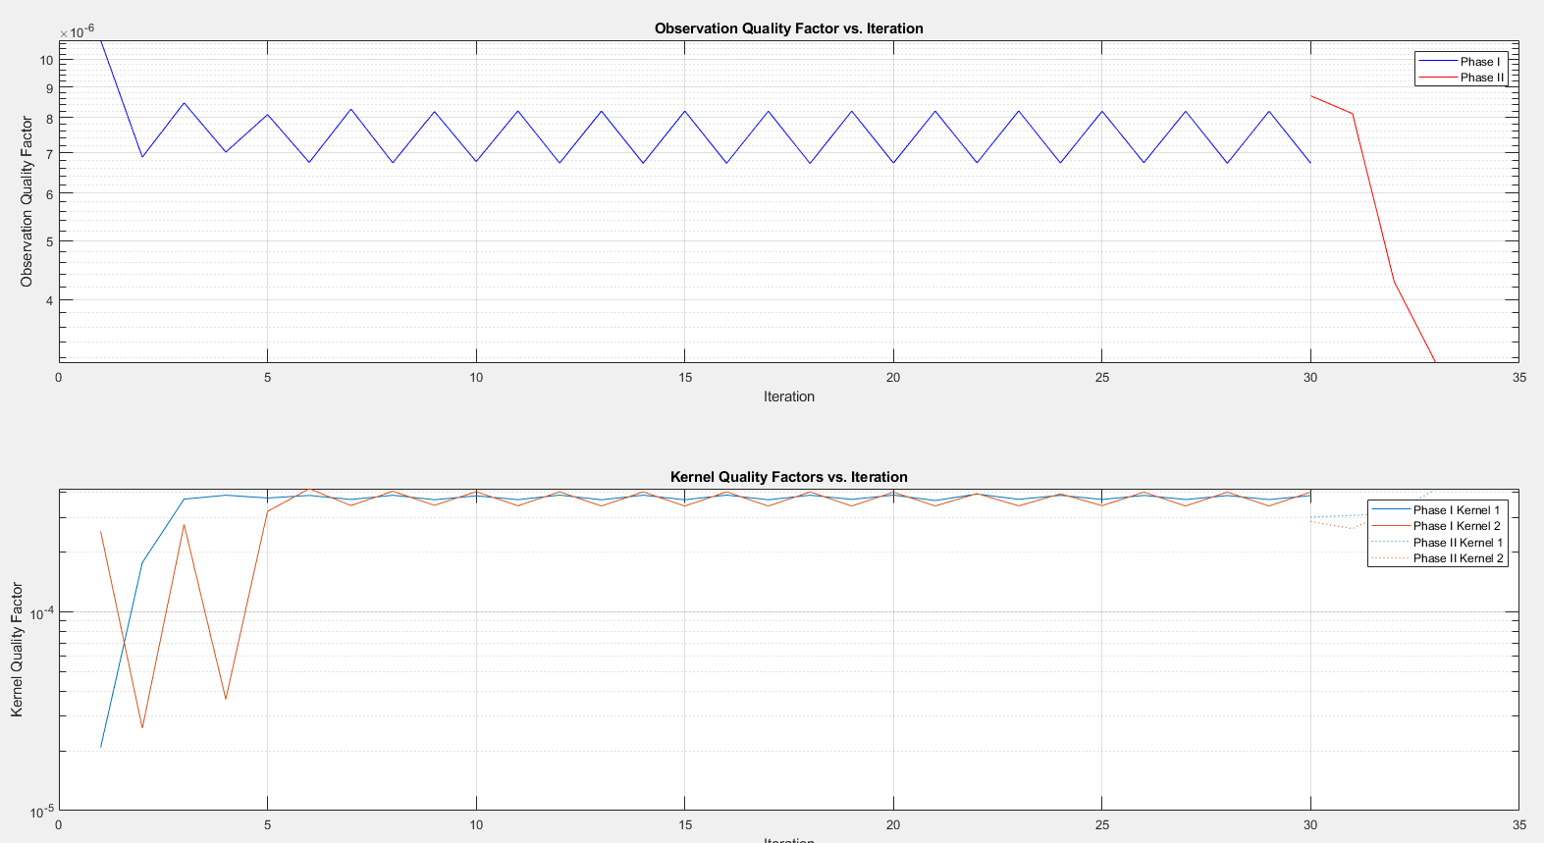

Slide 39
With Gaussian filter
NO gaussian

Slide 40
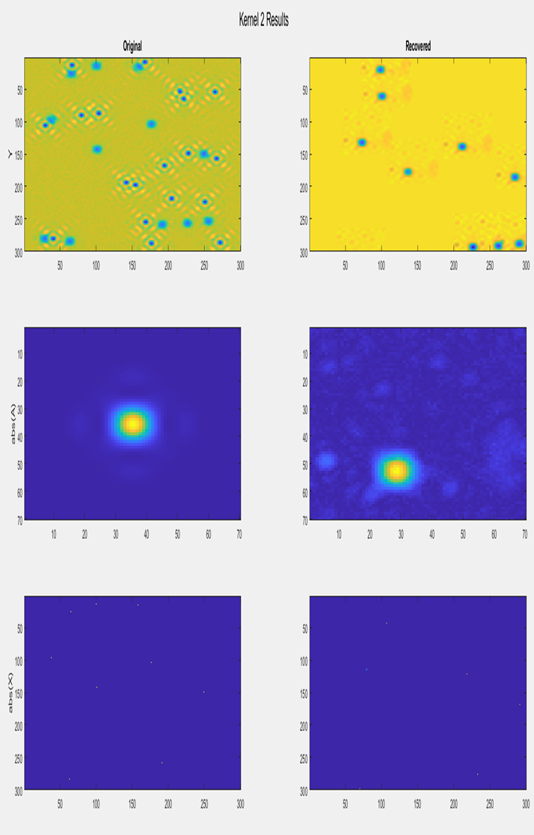
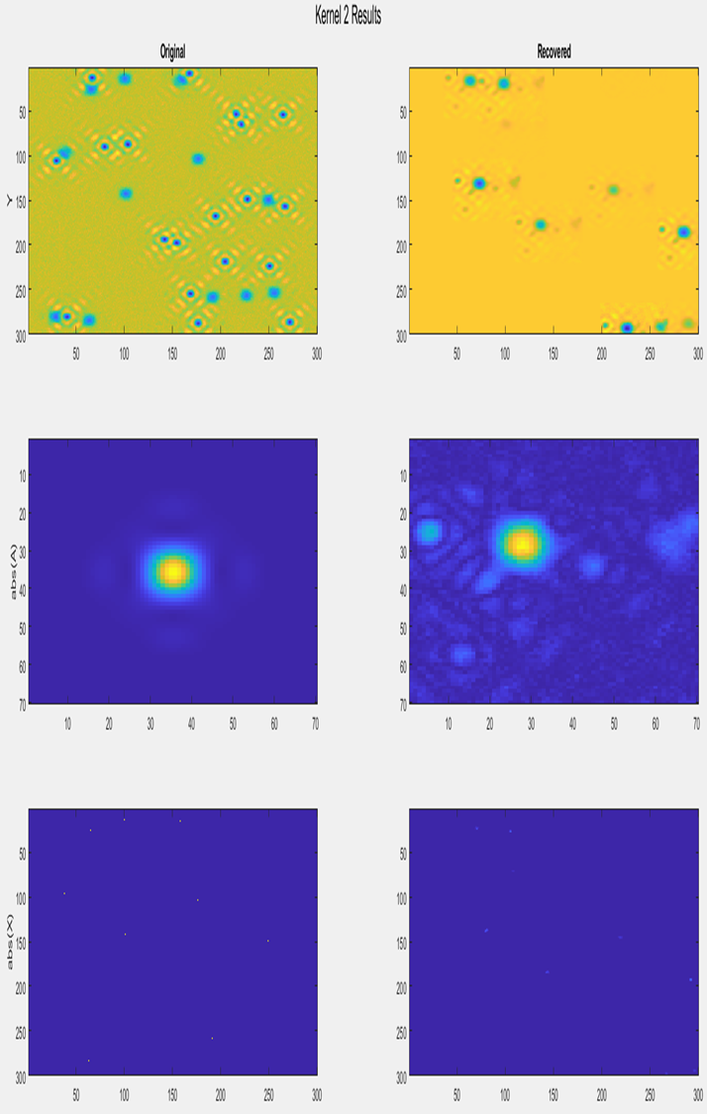
With Gaussian filter
NO gaussian

Slide 41
With Gaussian filter
NO gaussian

Slide 42
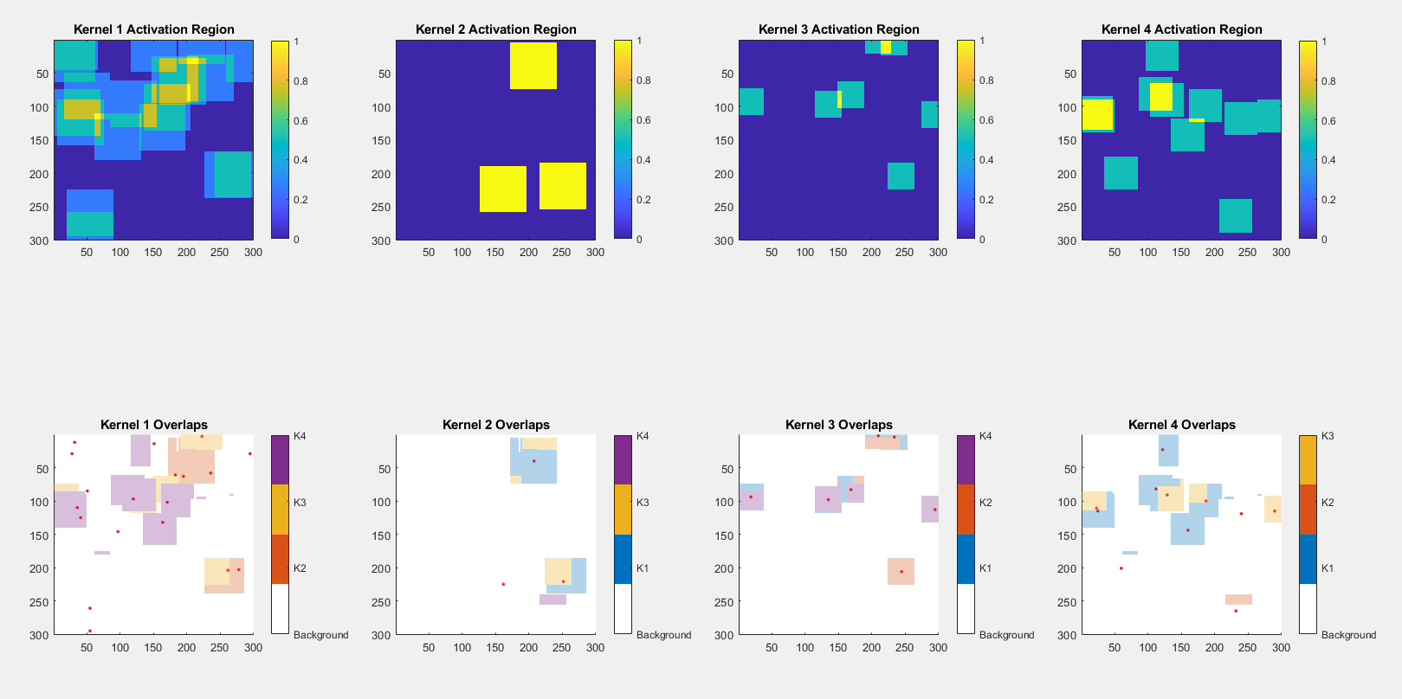
Algorithm design – shared overlapping algorithm

Slide 43
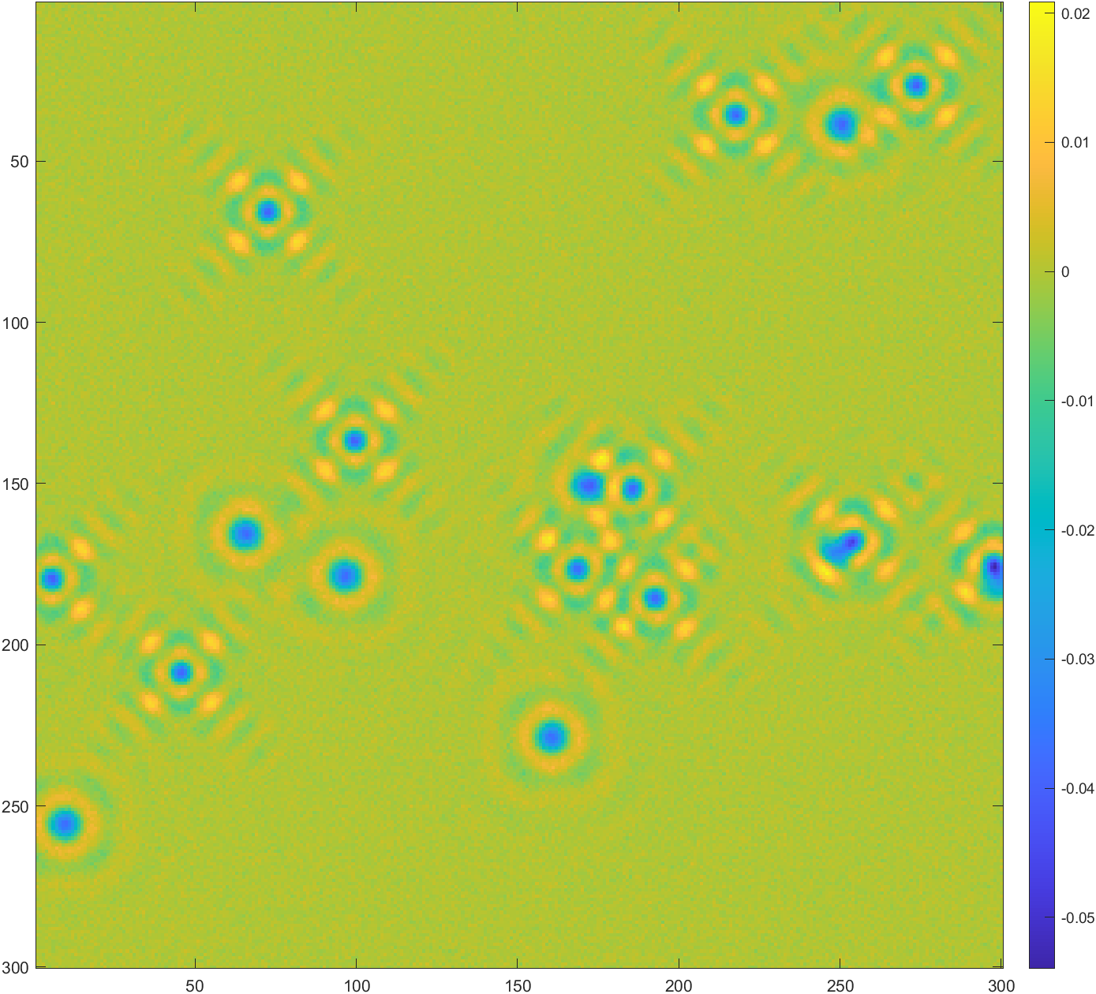
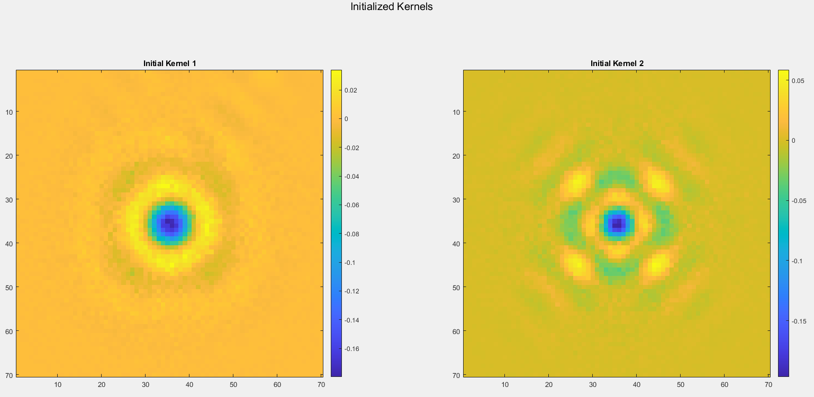
Algorithm design – shared overlapping algorithm
OUTCOME: BAD!!!
WHY? The symmetry of the observation is broken due to the overlapping addition, need to rethink how to deploy!!!

Slide 44
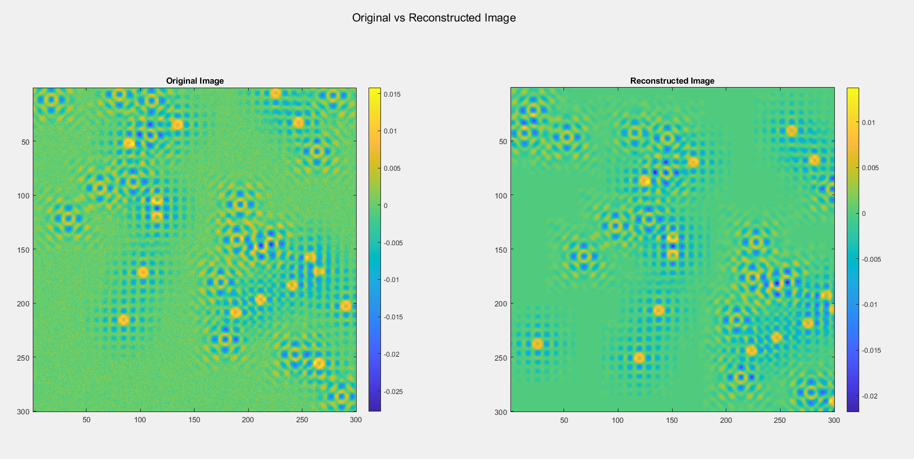

Slide 45
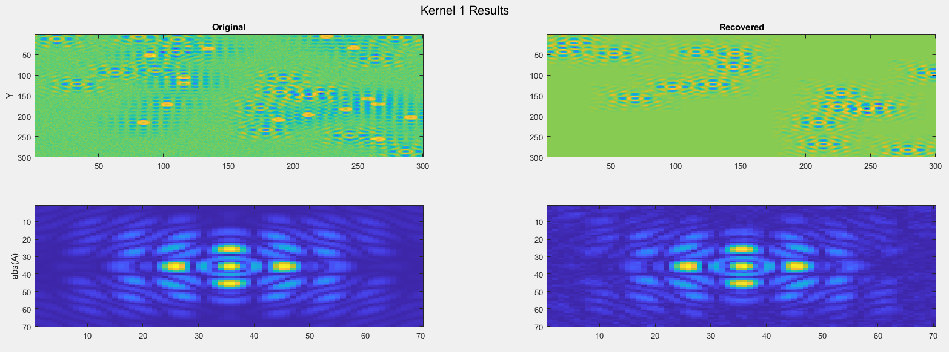
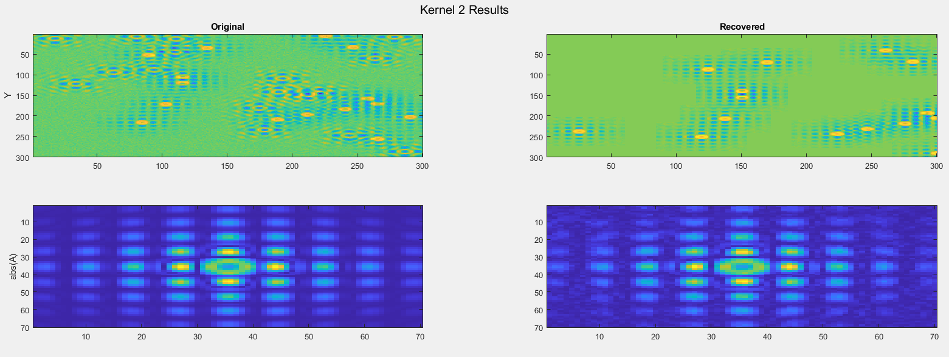

Slide 46
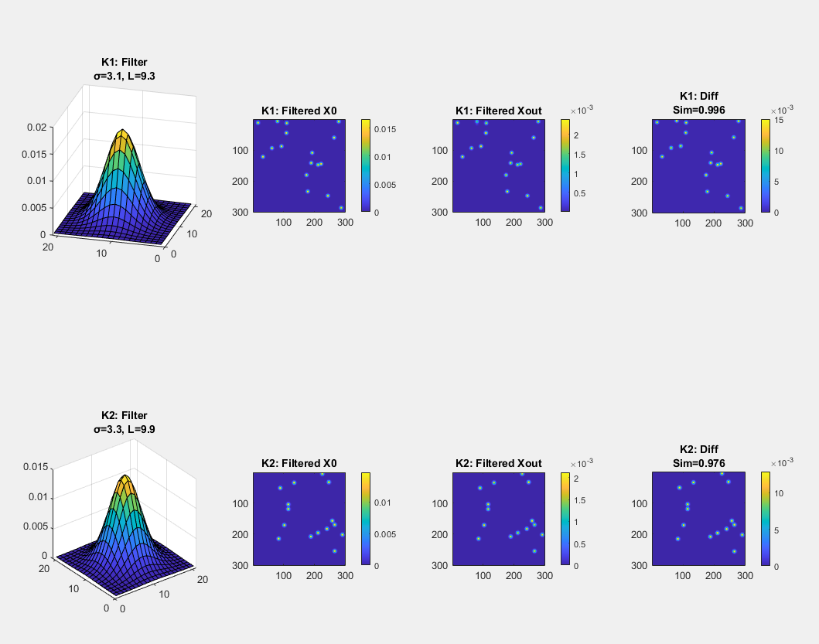

Slide 47
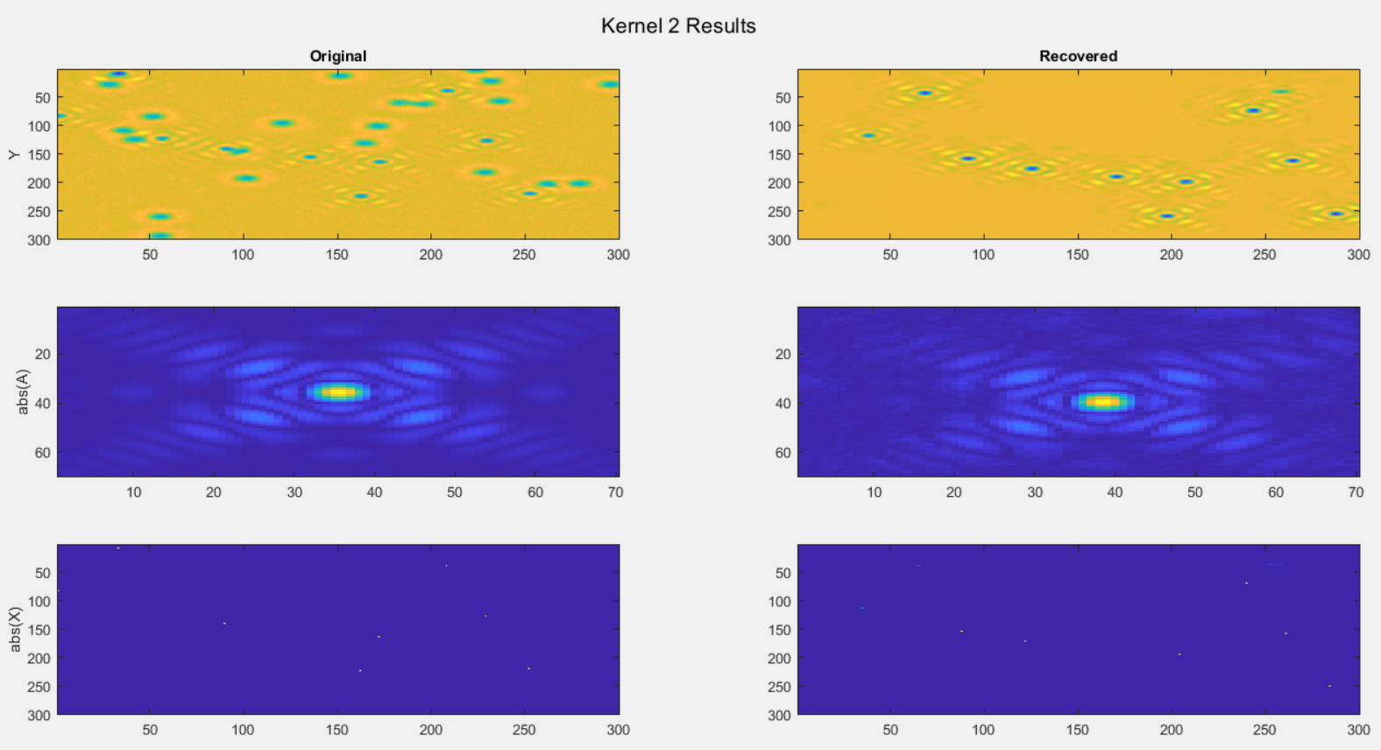

Test with kernels that have the same sign at the center

Slide 48


Slide 49


Test on the demixing attempt performance, SNR = 10

Slide 50

Deconvolution only

Slide 51

Deconvolution only

Slide 52

Deconvolution only

Slide 53

Deconvolution only

Slide 54

Deconvolution + Demixing

Slide 55

Deconvolution + Demixing

Slide 56

Deconvolution + Demixing

Slide 57

Deconvolution + Demixing

Slide 58

Deconvolution only
Noise robustness test SNR = 3
Result: SBD_STM_results_20241115_225312.mat
Analyzing Kernel Quality with QPI Patterns:
QPI-based Quality Factors:
Kernel 1: 0.9467
Kernel 2: 0.9379
Activation Reconstruction Metrics:
Kernel 1:
Alignment Quality: 0.9894
Similarity Score: 0.9900
Offset: [1, 0]
Kernel 2:
Alignment Quality: 0.9984
Similarity Score: 0.9992
Offset: [1, 0]

Slide 59

Noise robustness test SNR = 1.5
Result: SBD_STM_results_20241116_124411.mat
Analyzing Kernel Quality with QPI Patterns:
QPI-based Quality Factors:
Kernel 1: 0.9001
Kernel 2: 0.8786
Activation Reconstruction Metrics:
Kernel 1:
Alignment Quality: 0.9801
Similarity Score: 0.9595
Offset: [1, 0]
Kernel 2:
Alignment Quality: 0.9991
Similarity Score: 0.9992
Offset: [-1, -1]

Slide 60

Noise robustness test SNR = 0.5
Result: SBD_STM_results_20241116_155946.mat
Analyzing Kernel Quality with QPI Patterns:
QPI-based Quality Factors:
Kernel 1: 0.7622
Kernel 2: 0.7057
Activation Reconstruction Metrics:
Kernel 1:
Alignment Quality: 0.9586
Similarity Score: 0.9540
Offset: [0, 0]
Kernel 2:
Alignment Quality: 0.9948
Similarity Score: 0.9941
Offset: [-1, -1]

Slide 61

Trials with 3 kernels

Slide 62

Trials with 3 kernels

Slide 63

Trials with 3 kernels

Slide 64

Trials with 3 kernels

Slide 65


Slide 66


Slide 67


Slide 68


Slide 69
Metrics for now
Kernel similarity: corr2(normalized(fft(Aout))-normalized(fft(A0)))
Activation similarity: first shift, then guassian window, then normalized(dot(Xout_shifted,X0))-> cosine similarity
Residual quality: var(noise)/var(Y-sum-(Y_each_kernel))
Demixing score: 1-IoU(activationA,activationB) for A,B in all activation maps

Slide 70



Residual quality: var(noise)/var(Y-sum(Y_each_kernel)), ~1 if good reconstruction

Slide 71
Run of synthetic_datasets_20241127_170302 : Finished on Dec 3rd 2024
parameter index List
Dataset
| Dataset_idx | theta_cap | kernel_size | SNR | Description |
|------------|-----------|-------------|-----|-------------|
| 1 | 1e-3 | 0.16 | 1.0 | Hardest case |
| 2 | 1e-3 | 0.01 | 10.0| Hard theta |
| 3 | 1e-5 | 0.16 | 10.0| Hard kernel |
| 4 | 1e-5 | 0.01 | 1.0 | Hard SNR |
| 5 | 1e-5 | 0.01 | 10.0| Easiest case |
| 6 | 1e-4 | 0.04 | 3.16| Medium all |
| 7 | 1e-4 | 0.04 | 10.0| Medium-Medium-Easy |
| 8 | 1e-4 | 0.01 | 3.16| Medium-Easy-Medium |
| 9 | 1e-4 | 0.01 | 10.0| Medium-Easy-Easy |
| 10 | 1e-5 | 0.04 | 3.16| Easy-Medium-Medium |
| 11 | 1e-5 | 0.04 | 10.0| Easy-Medium-Easy |
| 12 | 1e-5 | 0.01 | 3.16| Easy-Easy-Medium |
System
| Param_num | Lambda1 | mini_loop_iter |
|-----------|---------|----------------|
| 1 | 0.010 | 1 |
| 2 | 0.010 | 3 |
| 3 | 0.010 | 9 |
| 4 | 0.032 | 1 |
| 5 | 0.032 | 3 |
| 6 | 0.032 | 9 |
| 7 | 0.100 | 1 |
| 8 | 0.100 | 3 |
| 9 | 0.100 | 9 |
|10| 0.300 | 1 |
|11| 0.300 | 3 |
|12| 0.300 | 9 |
|13| 0.500 | 1 |
|14| 0.500 | 3 |
|15| 0.500 | 9 |

Slide 72
Run of synthetic_datasets_20241127_170302 : Finished on Dec 12th 2024
parameter index List
Dataset
| Dataset_idx | theta_cap | kernel_size | SNR | Description |
|------------|-----------|-------------|-----|-------------|
| 1 | 1e-3 | 0.16 | 1.0 | Hardest case |
| 2 | 1e-3 | 0.01 | 10.0| Hard theta |
| 3 | 1e-5 | 0.16 | 10.0| Hard kernel |
| 4 | 1e-5 | 0.01 | 1.0 | Hard SNR |
| 5 | 1e-5 | 0.01 | 10.0| Easiest case |
| 6 | 1e-4 | 0.04 | 3.16| Medium all |
| 7 | 1e-4 | 0.04 | 10.0| Medium-Medium-Easy |
| 8 | 1e-4 | 0.01 | 3.16| Medium-Easy-Medium |
| 9 | 1e-4 | 0.01 | 10.0| Medium-Easy-Easy |
| 10 | 1e-5 | 0.04 | 3.16| Easy-Medium-Medium |
| 11 | 1e-5 | 0.04 | 10.0| Easy-Medium-Easy |
| 12 | 1e-5 | 0.01 | 3.16| Easy-Easy-Medium |
System
| Param_num | Lambda1 | mini_loop_iter |
|-----------|---------|----------------|
| 1 | 0.050 | 1 |
| 2 | 0.050 | 3 |
| 3 | 0.050 | 5 |
| 4 | 0.200 | 1 |
| 5 | 0.200 | 3 |
| 6 | 0.200 | 5 |
| 7 | 0.400 | 1 |
| 8 | 0.400 | 3 |
| 9 | 0.400 | 5 |
data_8 parameter_5: the 2 output kernels are reversed

Slide 73
How we define our metrics

